Slide 1
INFO 6105 Data Science Engineering Methods and Tools Statistics and Probability
Nik Bear Brown
nikbearbrown@gmail.com

Slide 2

Probability and Statistics

Slide 3
Tom Mitchell’s Definition of Learning
A computer program is said to learn from experience E with respect to some class of tasks T and performance measure P, if its performance at tasks in T, as measured by P, improves with experience E.
Example 1: Learn to play checkers
T: play checkers and win
P: % of games won in the world tournament
E: opportunity to play against self.
Example 2: Learn to detect SPAM
T: Distinguish between SPAM and HAM
P: % of emails correctly classified
E: Labeled emails from your friend Robin
Notes:
TPE gives a way to specify learning tasks, what if we wanted to train a computer to recognize handwriting, what would T, P and E be?
T: recognize and classify hand-written words within images
P: % words correctly classified
E: a database of handwritten words with characters labeled.
Simon’s definition of ML: Learning denotes changes in the system that are adaptive in the sense that they enable the system to do the same task or tasks drawn from the SAME POPULATION more effectively next time”

Slide 4
Learning from Data
Supervised Learning: each example has a label (discrete or continuous)
Reinforcement Learning: feedback after a sequence of actions/decisions
Unsupervised Learning: no feedback, goal is to group data into similar groups

Slide 5
Supervised Learning: Classification
Given a set of examples (training data), each described by a set of attributes, and labeled with a class
Find a model for the class attribute as a function of the values of other attributes
Goal: classify previously unseen data accurately
Notes:
Data

Slide 6
Classification Applications
Fraud Detection: Predict fraudulent cases in credit card transactions for a particular account
Training data: previous transactions of a particular account holder
Attributes: time of purchase, product type, cost, location, etc
Class: Label transactions as fraud or fair
Telephone Operator Support: determine whether and arbitrary caller said “yes” or “no”.
Training data: Signal of caller’s voice accepting or declining an offer
Attributes: features computed from the signal
Class: Label each signal as “yes” or “no”
Notes:
Why do we need to learn a model per customer?

Slide 7
Supervised Learning: Regression
Predict a value of a given continuous valued variable based on the values of the attributes
Well studied in statistics, neural networks, recent focus in Machine Learning is on non-linear models using SVMs
Examples:
Predicting sales amounts of new product based on advertising expenditure
Predicting your score on Netflix
Time series prediction of stock market indices
Notes:
Data

Slide 8
Unsupervised Learning: Clustering
Given a set of data points, each described by a set of attributes, find clusters such that:
Inter-cluster similarity is
maximized
Intra-cluster similarity is
minimized
Requires the definition of a similarity measure
F1
x
x
x
x
x
x
x
x
xx
x
x
x
x
x
x
xx
x
F2
Notes:
Data

Slide 9
Clustering Applications
Goal: divide customers into distinct groups based on behavior or demographics, with the goal of selecting a marketing target
Training data: Use detailed record of transactions, web behavior, demographics, etc
Attributes: Web pages visited, call frequency, length of call, financial status, marital status, size of investment, etc.
Online recommender systems (Netflix, Amazon, Perseus Digital Library)

Slide 10
Probability
Probability is the measure of the likelihood that an event will occur.
0
1.0
0.5
The occurrence of the event is just as likely as it is unlikely

Slide 11
Probability
Probability is a measure of the likelihood of a random phenomenon or chance behavior. Probability describes the long-term proportion with which a certain outcome will occur in situations with short-term uncertainty.
Probability is expressed in numbers between 0 and 1. Probability = 0 means the event never happens; probability = 1 means it always happens.
The total probability of all possible event always sums to 1.

Slide 12
Probability
The probability of an event equals the number of times it happens divided by the number of opportunities.
These numbers can be determined by experiment or by knowledge of the system.
For instance, rolling a die (singular of dice). The chance of rolling a 2 is 1/6, because there is a 2 on one face and a total of 6 faces. So, assuming the die is balanced, a 2 will come up 1 time in 6.
It is also possible to determine probability by experiment: if the die were unbalanced (loaded = cheating), you could roll it hundreds or thousands of times to get the actual probability of getting a 2. For a fair die, the experimentally determined number should be quite close to 1/6, especially with many rolls.
0.5

Slide 13
Assigning Probabilities
Classical approach: make certain assumptions (such as equally likely, independence) about situation.
Relative frequency: assigning probabilities based on experimentation or historical data.
Subjective approach: Assigning probabilities based on the assignor’s judgment. [Bayesian]
0.5

Slide 14
Sample Space
Coin Toss ={head,tail}
Two coins S = {HH, HT, TH, TT}
Inspecting a part ={good,bad}
Rolling a die S ={1,2,3,4,5,6}

Slide 15
Probability
The probability of any event E, P(E), must be between 0 and 1 inclusive. That is,
0 < P(E) < 1.
2. If an event is impossible, the probability of the event is 0.
3. If an event is a certainty, the probability of the event is 1.
4. If S = {e₁, e₂, …, e_{n}}, then
P(e₁) + P(e₂) + … + P(e_{n}) = 1.

Slide 16
Unions and Intersections
AND Rule of Probability
The probability of 2 independent events both happening is the product of their individual probabilities.
Called the AND rule because “this event happens AND that event happens”.
For example, what is the probability of rolling a 2 on one die and a 2 on a second die? For each event, the probability is 1/6, so the probability of both happening is 1/6 x 1/6 = 1/36.
Note that the events have to be independent.

Slide 17
Probability - The OR Rule of Probability
The probability that either one of 2 different events will occur is the sum of their separate probabilities.
For example, the chance of rolling either a 2 or a 3 on a die is 1/6 + 1/6 = 1/3.

Slide 18
Joint Probability
For events A and B, joint probability Pr(AB) stands for the probability that both events happen.
Example: A={HH}, B={HT, TH}, what is the joint probability Pr(AB)?

Slide 19
Independence
Two events A and B are independent in case
Pr(AB) = Pr(A)Pr(B)
A set of events {A_{i}} is independent in case

Slide 20
Conditional Probability
If A and B are events with Pr(A) > 0, the conditional probability of B given A is

Slide 21
Mutually Exclusive Events
The OR Rule of Probability
Mutually exclusive events-no outcomes from S in common
A ∩ Β = ∅
S
A
B

Slide 22
Probability - The OR Rule of Probability
The probability that either one of 2 different events will occur is the sum of their separate probabilities.
For example, the chance of rolling either a 2 or a 3 on a die is 1/6 + 1/6 = 1/3.

Slide 23
Probability - NOT Rule
The chance of an event not happening is 1 minus the chance of it happening.
For example, the chance of not getting a 2 on a die is 1 - 1/6 = 5/6.
This rule can be very useful. Sometimes complicated problems are greatly simplified by examining them backwards.
P(A’ ) = 1 - P(A)
For an event A, A’ is the complement of A; A’ is everything in S that is not in A.
A'
A

Slide 24
Probability
if A and B are mutually exclusive events:
P(A or B) = P(A) + P(B)
ex., die roll: P(1 or 6) = 1/6 + 1/6 = .33
possibility set:
sum of all possible outcomes
~A = anything other than A
P(A or ~A) = P(A) + P(~A) = 1

Slide 25
Probability
one event has no influence on the outcome of another event
if events A & B are independent
then P(A&B) = P(A)*P(B)
if P(A&B) = P(A)*P(B)
then events A & B are independent
coin flipping
if P(H) = P(T) = .5 then
P(HTHTH) = P(HHHHH) =
.5*.5*.5*.5*.5 = .5⁵ = .03

Slide 26
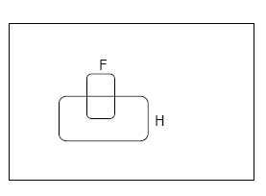
Conditional Probability
P(F|H) = Fraction of worlds in which H is true that also have F true

Slide 27
The Axioms of Probability
0 <= P(A) <= 1
P(True) = 1
P(False) = 0
P(A or B) = P(A) + P(B) - P(A and B)
Where do these axioms come from? Were they “discovered”?
Answers coming up later.

Slide 28
Theorems from the Axioms
0 <= P(A) <= 1, P(True) = 1, P(False) = 0
P(A or B) = P(A) + P(B) - P(A and B)
From these we can prove:
P(not A) = P(~A) = 1-P(A)

Slide 29
Another important theorem
0 <= P(A) <= 1, P(True) = 1, P(False) = 0
P(A or B) = P(A) + P(B) - P(A and B)
From these we can prove:
P(A) = P(A ^ B) + P(A ^ ~B)

Slide 30
Multivalued Random Variables
Suppose A can take on more than 2 values
A is a random variable with arity k if it can take on exactly one value out of {v₁,v₂, .. v_{k}}
Thus…

Slide 31
Density Estimation
Our Joint Distribution learner is our first example of something called Density Estimation
A Density Estimator learns a mapping from a set of attributes to a Probability
Input
Attributes
Density
Estimator
Probability

Slide 32
Density Estimation
Compare it against the two other major kinds of models:
Input
Attributes
Classifier
Prediction of
categorical output
Input
Attributes
Density
Estimator
Probability
Input
Attributes
Regressor
Prediction of
real-valued output

Slide 33
Evaluating Density Estimation
Test-set criterion for estimating performance on future data*
* See the Decision Tree or Cross Validation lecture for more detail
Input
Attributes
Test set Accuracy
Classifier
Prediction of
categorical output
Input
Attributes
Density
Estimator
?
Probability
Input
Attributes
Prediction of
real-valued output
Test set Accuracy
Regressor

Slide 34
A note about independence
Assume A and B are Boolean Random Variables. Then
“A and B are independent”
if and only if
P(A|B) = P(A)
“A and B are independent” is often notated as
Notes:
Before we discuss how to evaluate a density estimator, we need to understand the concept of independence

Slide 35
Independence Theorems
Assume P(A|B) = P(A)
Then P(A^B) =
= P(A) P(B)
Assume P(A|B) = P(A)
Then P(B|A) =
= P(B)

Slide 36
Independence Theorems
Assume P(A|B) = P(A)
Then P(~A|B) =
= P(~A)
Assume P(A|B) = P(A)
Then P(A|~B) =
= P(A)

Slide 37
Multivalued Independence
For multivalued Random Variables A and B,
if and only if
from which you can then prove things like…

Slide 38
Evaluating a Density Estimator
Given a record x, a density estimator M can tell you how likely the record is:
Given a dataset with R records, a density estimator can tell you how likely the dataset is:
(Under the assumption that all records were independently generated from the Density Estimator’s JD)
Notes:
What is M???? -- the the joint density table that we learned from the table!

Slide 39
Log Probabilities
Since probabilities of datasets get so small we usually use log probabilities
Notes:
16 > 4
Log 16 > log 4

Slide 40
Probability Trees [Decision Trees]…
A probability tree is a simple and effective method of applying the probability rules by representing events in an experiment by lines. The resulting figure resembles a tree.
First selection
Second selection
P(F|F) = 2/9
P(F) = 3/10
P( M|F) = 7/9
P(F|M) = 3/9
P( M) = 7/10
P( M|M) = 6/9

Slide 41
Probability Trees…
At the ends of the “branches”, we calculate joint probabilities as the product of the individual probabilities on the preceding branches.
Sample Space:[F₁*F₂, F₁*M₂, M₁*F₂, M₁*M₂]
Joint probabilities
First selection
Second selection
P(FF)=(3/10)(2/9)
P(F|F) = 2/9
P(F) = 3/10
P( M|F) = 7/9
P(FM)=(3/10)(7/9)
P(F|M) = 3/9
P(MF)=(7/10)(3/9)
P( M) = 7/10
P( M|M) = 6/9
P(MM)=(7/10)(6/9)

Slide 42
Random variables
Random variables assign a real number to each
outcome:
Random variables can be:
Discrete: if it takes at most countably many
values (integers).
Continuous: if it can take any real number.

Slide 43
Random variables
Distribution of a random variable
(i) when
(ii) when
is nondecreasing.
is right-continuous.
when

Slide 44
Random variables
For a random variable, we define
Probability function
Density function,
depending on whether it is discrete or continuous

Slide 45
Random variables
Probability function
verifies

Slide 46
Random variables
Probability density function
verifies
We have
RANDOM VARIABLES
46

Slide 47
Random variables
completely determines the distribution
of a random variable.

Slide 48
Discrete Random Variables
Random variables (RVs) which may take on only a countable number of distinct values
E.g. the total number of tails X you get if you flip 100 coins
X is a RV with arity k if it can take on exactly one value out of {x₁, …, x_{k}}
E.g. the possible values that X can take on are 0, 1, 2, …, 100

Slide 49
Probability of Discrete RV
Probability mass function (pmf): P(X = x_{i})
Easy facts about pmf
Σ_{i} P(X = x_{i}) = 1
P(X = x_{i}∩X = x_{j}) = 0 if i ≠ j
P(X = x_{i} U X = x_{j}) = P(X = x_{i}) + P(X = x_{j}) if i ≠ j
P(X = x₁ U X = x₂ U … U X = x_{k}) = 1

Slide 50
Continuous Random Variables
Probability density function (pdf) instead of probability mass function (pmf)
A pdf is any function f(x) that describes the probability density in terms of the input variable x.

Slide 51
Probability of Continuous RV
Properties of pdf
Actual probability can be obtained by taking the integral of pdf
E.g. the probability of X being between 0 and 1 is

Slide 52
Random variables
Bernoulli
p
1-p
p
1-p
0 1
0 1

Slide 53
Random variables
Binomial
Successes in n independent Bernoulli trials with
success probability p

Slide 54
Random variables
Geometric
Time of first success in a sequence of independent
Bernoulli trials with success probability p

Slide 55
Random variables
Poisson
X expresses the number of “ rare events”

Slide 56
Random variables
Uniform
F(x)
f(x)
a b
a b
RANDOM VARIABLES
56

Slide 57
Random variables
Exponential
1/β
1
F(x)
f(x)
0 β
RANDOM VARIABLES

Slide 58
Random variables
Normal
f(x)
F(x)
μ

Slide 59
Random variables
Properties of normal distribution
standard normal
(ii)
(iii) independent i=1,2,...,n

Slide 60
Random variables
Two random variables X and Y are independent if
and only if:
for all values x and y.

Slide 61
Random variables
Discrete variables
Continuous variables
If X and Y are independent:
RANDOM VARIABLES

Slide 62
Random variables
Properties:
(i)
If are independent then:

Slide 63
Random variables
Moment of order k

Slide 64
Random variables
Variance
Given X with :
standard deviation

Slide 65
Permutations
A B C D E
How many ways can we choose 2 letters from the above 5, without replacement, when the order in which we choose the letters is important?
5 × 4 = 20

Slide 66
Permutations (cont.)

Slide 67
Combinations
A B C D E
How many ways can we choose 2 letters from the above 5, without replacement, when the order in which we choose the letters is not important?
5 × 4 = 20 when order important
Divide by 2: (5 × 4)/2 = 10 ways
N choose K (5 choose 2)

Slide 68
Bounding Numbers of Combinations
= number of (unordered) combinations of n objects taken k at a time
N choose K

Slide 69
Combinations (cont.)

Slide 70
Tail Bounds
In the analysis of randomized algorithms, we need to know how much does an algorithms run-time/cost deviate from its expected run-time/cost.
That is we need to find an upper bound on Pr[X deviates from E[X] a lot]. This we refer to as the tail bound on X.

Slide 71
Markov and Chebychev Inequalities
Markov Inequality (uses only mean)
Chebychev Inequality (uses mean and variance)

Slide 72
Markov and Chebychev Inequalities
Example, if B is a Binomial with parameters n,p

Slide 73

Chernoff bounds
The Chernoff bound for a random variable X is
obtained as follows: for any t >0,
Pr[X  a] = Pr[e^{tX}  e^{ta}] ≤ E[e^{tX} ] / e^{ta}
Similarly, for any t <0,
Pr[X  a] = Pr[e^{tX}  e^{ta}] ≤ E[e^{tX} ] / e^{ta}
The value of t that minimizes E[e^{tX} ] / e^{ta} gives the best possible bounds.

Slide 74
Chernoff Bound of Random Variable A
Uses all moments
Uses moment generating function
By setting x = γ’ (s) 1st derivative minimizes bounds

Slide 75
Chernoff Bound of Discrete Random Variable A
Choose z = z₀ to minimize above bound
Need Probability Generating function

Slide 76
Chernoff Bounds for Binomial B with parameters n,p
Above mean x ≥ μ

Slide 77
Chernoff Bounds for Binomial B with parameters n,p
Below mean x ≤ μ

Slide 78
Birthday Problem
What is the smallest number of people you need in a group so that the probability of 2 or more people having the same birthday is greater than 1/2?
Answer: 23
No. of people 23 30 40 60
Probability .507 .706 .891 .994

Slide 79
Birthday Problem
A={at least 2 people in the group have a common birthday}
A’ = {no one has common birthday}

Slide 80
Information Theory
P(X) encodes our uncertainty about X
Some variables are more uncertain that others
How can we quantify this intuition?
Entropy: average number of bits required to encode X

Slide 81
Information Theory
Entropy: average number of bits required to encode X
We can define conditional entropy similarly
i.e. once Y is known, we only need H(X,Y) – H(Y) bits
We can also define chain rule for entropies (not surprising)

Slide 82
Information Theory - Rényi entropies
Rényi entropies*
Alpha is an integral number 0,1,2,3 …

Slide 83
Information Theory - Rényi entropies
Hartley entropy
The Hartley entropy [Gray, 1990] (Equation 5) is the Rényi entropy with an alpha (α) of zero

Slide 84
Information Theory - Rényi entropies
Shannon entropy
The Shannon entropy is the Rényi entropy with an alpha (α) of one.

Slide 85
Information Theory - Rényi entropies
collision entropy
The collision entropy is the Rényi entropy with an alpha of two and is sometimes just called "Rényi entropy."

Slide 86
Information Theory - Rényi entropies
min-entropy
The min-entropy is the Rényi entropy as the limit of alpha (α) approaches infinity.

Slide 87
Kullback-Leibler divergence
Kullback-Leibler divergence
KL divergence is calculated by weighting one distribution (like an observed frequency distribution) by the log of probabilities of some other distribution D₂
Kullback-Leibler divergence [Gray, 1990] (Equation 9) is a non-symmetric measure of the difference between two probability distributions. The Kullback-Leibler measure goes by several names: relative entropy, discrimination information, Kullback-Leibler (KL) number, directed divergence, informational divergence, and cross entropy

Slide 88
Mutual Information: MI
Remember independence?
If X⊥Y then knowing Y won’t change our belief about X
Mutual information can help quantify this! (not the only way though)
MI:
“The amount of uncertainty in X which is removed by knowing Y”
Symmetric
I(X;Y) = 0 iff, X and Y are independent!

Slide 89
Mutual Information: MI
Mutual information quantifies the mutual dependence of the two random variables. It is a measure of the “stickiness” between two items. It measures how much knowing one of these variables reduces uncertainty about the other.

Slide 90
Validation
Divide the total dataset into three subsets:
Training data is used for learning the parameters of the model.
Validation data is not used of learning but is used for deciding what type of model and what amount of regularization works best.
Test data is used to get a final, unbiased estimate of how well the network works. We expect this estimate to be worse than on the validation data.
We could then re-divide the total dataset to get another unbiased estimate of the true error rate.

Slide 91
Boosting
Main Assumption:
Combining many weak predictors (e.g. tree stumps or 1-R predictors) to produce an ensemble predictor.
Hypothesis Space
Variable size (nonparametric): Can model any function

Slide 92
Boosting
Each predictor is created by using a biased sample of the training data
Instances (training examples) with high error are weighted higher than those with lower error
Difficult instances get more attention

Slide 93
Ensemble Learning
Ensemble learning is a machine learning paradigm where multiple learners are trained to solve the same problem. In contrast to ordinary machine learning approaches which try to learn one hypothesis from training data, ensemble methods try to construct a set of hypotheses and combine them to use.
Notes:
93

Slide 94
What is Ensemble Learning?
Ensemble: collection of base learners
Each learns the target function
Combine their outputs for a final predication
Often called “meta-learning”
How can you get different learners?
How can you combine learners?
Notes:
Give class one idea like using different learning algorithms and ask them to break up into groups and thinking of other ways to create ensembles.

Slide 95
Majority Vote Model
Let p be the probability that a classifier makes an error
Assume that classifier errors are independent
The probability that k of the n classifiers make an error is:
Therefore the probability that a majority vote classifier is in error is:
Notes:
What happens when p > .5???
95

Slide 96
Value of Ensembles
“No Free Lunch” Theorem
No single algorithm wins all the time!
When combing multiple independent decisions, each of which is at least more accurate than random guessing, random errors cancel each other out and correct decisions are reinforced
Human ensembles are demonstrably better
How many jelly beans are in the jar?
Who Wants to be a Millionaire: “Ask the audience”
Notes:
Majority vote is just one kind of ensemble, we will look at several
So what is our goal? We want to create an ensemble of classifiers that make independent errors

Slide 97
Ensemble Method1: Bagging
Create ensembles by “bootstrap aggregation”, i.e., repeatedly randomly re-sampling training data
Bootstrap: draw n items from X with replacement
Given a training set X of m instances
For
Draw sample of size n < m from X uniformly w/ replacement
Learn classifier C_{i} from sample i
Final classifier is an unweighted vote of C₁ .. C_{T}

Slide 98
Will Bagging Improve Accuracy?
Depends on the stability of the base classifiers
If small changes in the sample cause small changes in the base-level classifier, then the ensemble will not be much better than the base classifiers
If small changes in the sample cause large changes and the error is < ½ then we will see a big improvement
What algorithms are stable/unstable?
Notes:
Class discussion on which algorithms are stable.
-- Stable: k-NN, linear discriminant functions
-- Unstable: decision trees

Slide 99
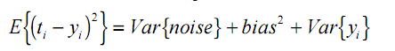
Bias-Variance Decomposition
The distance
from f
Variance of the
predictions
Independent
of predictor

Slide 100
Bias and Variance
Bias Problem
The hypothesis space made available by a particular classification method does not include the true hypothesis
Variance Problem
The hypothesis space is “too large” for the amount of training data – thus selected hypothesis may be inaccurate on unseen data

Slide 101
Why Bagging Improves Accuracy
Decreases error by decreasing the variance in the results due to unstable learners, algorithms (like decision trees and neural networks) whose output can change dramatically when the training data is slightly changed

Slide 102
Ensemble Method 2: Boosting:
Let m be the number of hypotheses to generate
Initialize all training instances to have the same weight
for i=1,m
generate hypothesis h_{i}
increase weights of the training instances that h_{i} misclassifies
Final classifier is a weighted vote of all m hypotheses (where the weights are set based on training set accuracy)
Notes:
There are many variants – differ in how to set the weights and how to combine hypotheses.

Slide 103
Adaboost
T is the number of iterations
m is the number of instances
H is the classifier algorithm
for
if then break
for
if then
else
end
end
return
Notes:
Z_t is a normalization factor that makes the D_i sum to 1 and be a probability distribution.
Z is calculated by adding up all of the D_t(i)e^\alpha^t for incorrect + D_t(i)e^-\alpha^t for the correct
Homework assignment – explain how to calculate the Z_t Or just give them a different example and have them calculate the D_t+1(i)
http://en.wikipedia.org/wiki/AdaBoost

Slide 104
Boosting
Originally developed by computational learning theorists to guarantee performance improvements on fitting training data for a weak learner that only needs to generate a hypothesis with a training accuracy greater than 0.5 (Schapire, 1990).
Revised to be a practical algorithm, AdaBoost, for building ensembles that empirically improves generalization performance (Freund & Shapire, 1996).

Slide 105
Strong and Weak Learners
“Strong learner” produces a classifier which can be arbitrarily accuracy
“Weak Learner” produces a classifier more accurate than random guessing
Original question: Can a set of weak learners create a single strong learner?

Slide 106
Summary of Boosting and Bagging
Called “homogenous ensembles”
Both use a single learning algorithm but manipulate training data to learn multiple models
Data1 ≠ Data2 ≠ … ≠ Data m
Learner1 = Learner2 = … = Learner m
Methods for changing training data:
Bagging: Resample training data
Boosting: Reweight training data
In WEKA, these are called meta-learners, they take a learning algorithm as an argument (base learner) and create a new learning algorithm

Slide 107
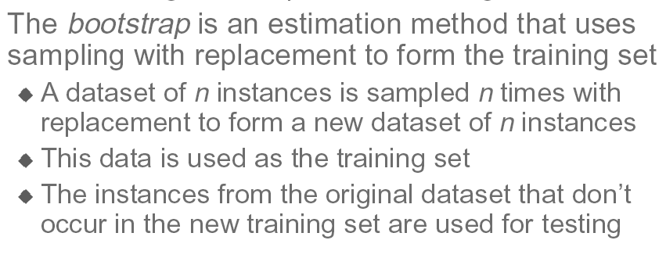
Boostrap Estimate

Slide 108
The Normal Distribution (Han & Kamber, 2006)
The normal or Gaussian density:
applies to continuous, real-valued random variables
characterized by mean (average) m and standard deviation s
density at x is defined as
(1/(s sqrt(2pi))) exp(-(x-m)²/2s²)
special case m = 0, s = 1: a exp(-x²/b) for some constants a,b > 0
peaks at x = m, then dies off exponentially rapidly
the classic “bell-shaped curve”
exam scores, human body temperature,
remarks:
can control mean and standard deviation independently
can make as “broad” as we like, but always have finite variance

Slide 109
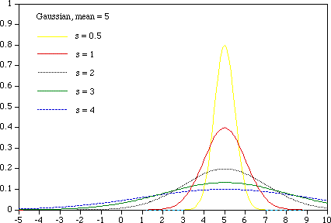
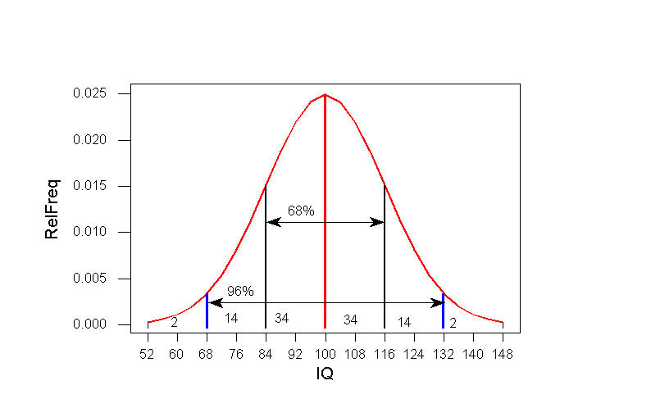
The Normal Distribution (Han & Kamber, 2006)

Slide 110
The Binomial Distribution (Han & Kamber, 2006)
coin with Pr[heads] = p, flip n times
probability of getting exactly k heads:
choose(n,k) p^{k}(1-p)^{n-k}
for large n and p fixed:
approximated well by a normal with
m = np, s = sqrt(np(1-p))
s/m → 0 as n grows

Slide 111
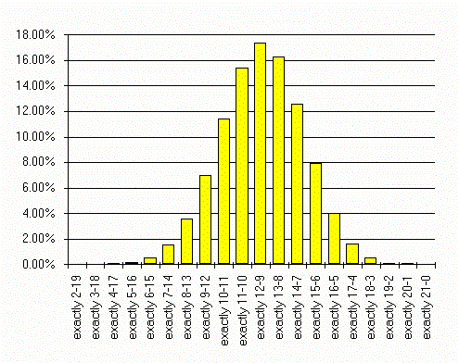
The Binomial Distribution (Han & Kamber, 2006)
www.professionalgambler.com/ binomial.html
Notes:
Say you have a 57.5% chance of winning each and every bet. How many winners can you expect in the next 21 bets?
57.5% of 21 is 12.075, so you can expect a win loss record of 12-9
But this is not the only thing that can happen, several other outcomes are very likely. The graph shows the binomial distribution of all possible outcomes.
Although 12-9 is the most “likely” is will occur only slightly more than 17% of the time. That’s about 1 in 6 so in real life you can figure you’ll get an outcome other than 12-9 about 5 of 6 times.

Slide 112
The Poisson Distribution (Han & Kamber, 2006)
like binomial, applies to variables taking on integer values > 0
often used to model counts of events
number of phone calls placed in a given time period
number of times a neuron fires in a given time period
single free parameter l
probability of exactly x events:
exp(-l) l^{x}/x!
mean and variance are both l
binomial distribution with n large, p = l/n (l fixed)
converges to Poisson with mean l

Slide 113
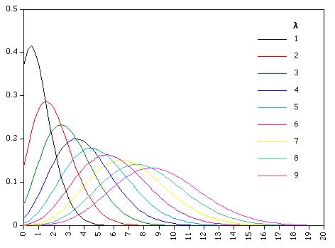
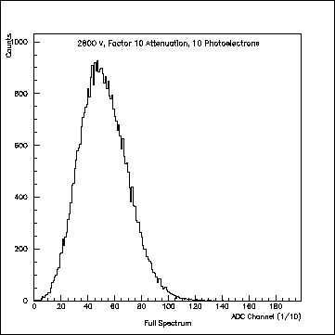
The Poisson Distribution (Han & Kamber, 2006)
single photoelectron distribution

Slide 114
Fat-Tailed Distributions
Power law distributions:
for variables assuming integer values > 0
Prob [X=k] ~ Ck^{-α}
typically 0 < alpha < 2; smaller a gives heavier tail
For binomial, normal, and Poisson distributions the tail probabilities approach 0 exponentially fast
What kind of phenomena does this distribution model?
What kind of process would generate it?

Slide 115
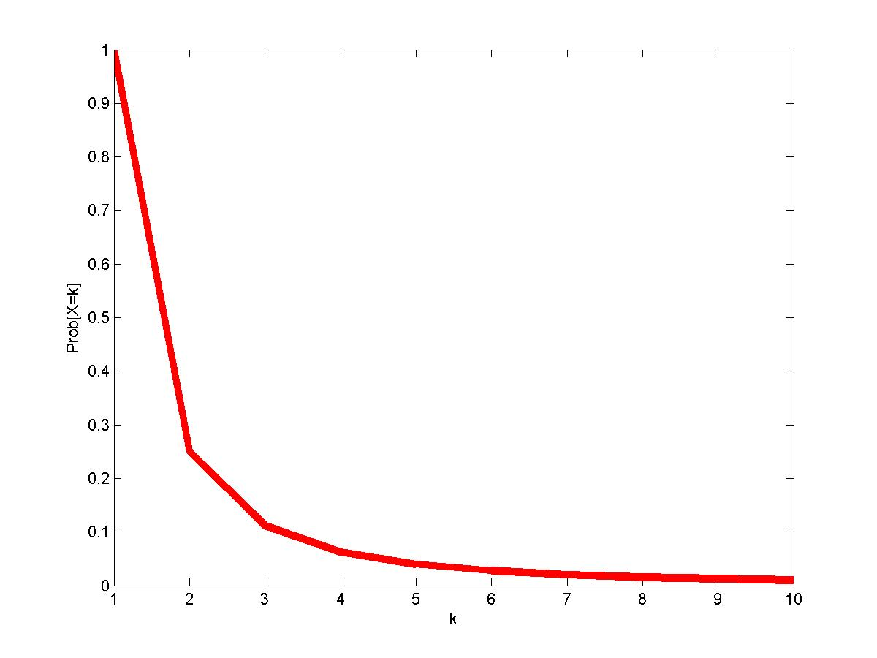
Power Law: Prob [X=k] = k⁻²

Slide 116
Power Law
Prob [X=k] ~ Ck^{-α}
log Prob [X=k] ~ log C –α log k
Prob [X=k] = k⁻²
log Prob [X=k] = -2 log k

Slide 117
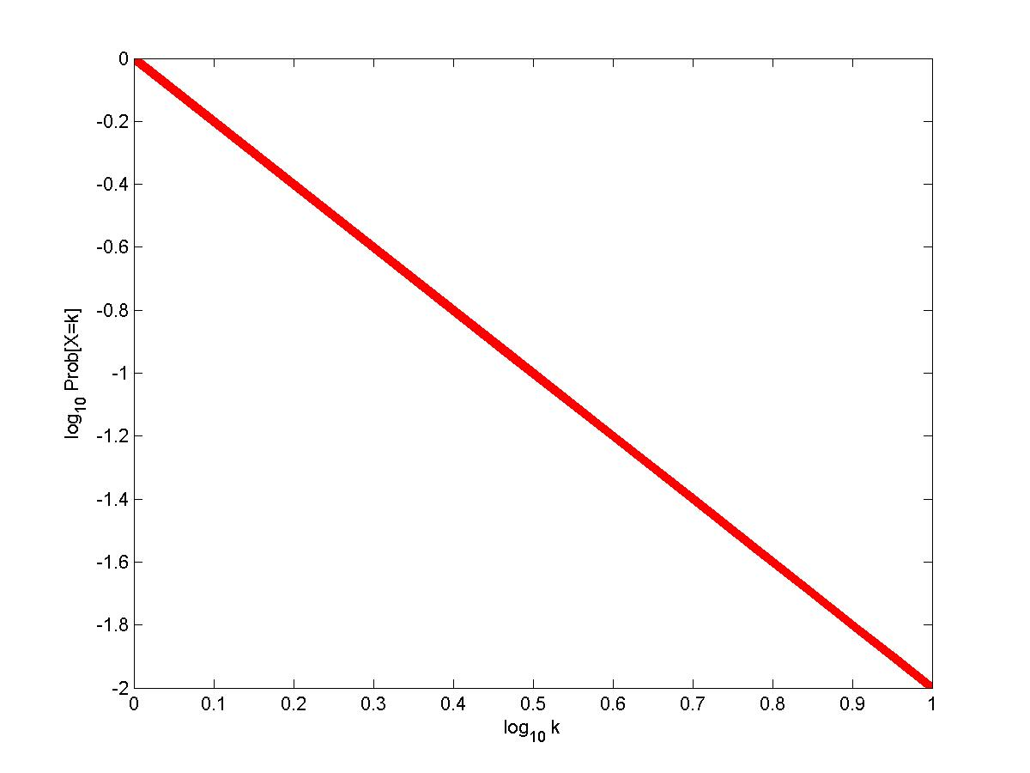
Power Law: Log-Log plot

Slide 118
Power Law contd.
More general definition:
Prob [X≥k] ~ Ck^{-α}
Particularly useful if X takes on real values.
Sometimes referred to as “heavy tailed” or “scale free.”

Slide 119
Power Laws in Degree distribution
Let G be a graph.
Let X_{k} be the proportion of nodes with degree k in G.
Then if X_{k} ~ Ck^{-α}
we say that G has power law degree distribution.

Slide 120
Exploratory Data Analysis (EDA)
Goal: get a general sense of the data
means, medians, quantiles, histograms, boxplots
You should always look at every variable - you will learn something!
data-driven (model-free)
Think interactive and visual
Humans are the best pattern recognizers
You can use more than 2 dimensions!
x,y,z, space, color, time….
especially useful in early stages of data mining
detect outliers (e.g. assess data quality)
test assumptions (e.g. normal distributions or skewed?)
identify useful raw data & transforms (e.g. log(x))
Bottom line: it is always well worth looking at your data!

Slide 121
Summary Statistics
not visual
sample statistics of data X
mean: μ = ∑_{i} X_{i} / n
mode: most common value in X
median: X=sort(X), median = X_{n/2} (half below, half above)
quartiles of sorted X: Q1 value = X_{0.25n} , Q3 value = X_{0.75 n}
interquartile range: value(Q3) - value(Q1)
range: max(X) - min(X) = X_{n} - X₁
variance: σ² = ∑_{i} (X_{i} - μ)² / n
skewness: ∑_{i} (X_{i} - μ)³ / [ (∑_{i} (X_{i} - μ)²)^{3/2} ]
zero if symmetric; right-skewed more common (what kind of data is right skewed?)
number of distinct values for a variable (see unique() in R)
Don’t need to report all of thses: Bottom line…do these numbers make sense???

Slide 122
Types of Variables
Continuous variables:
Always numeric
Can be any number, positive or negative
Examples: age in years, weight, blood pressure readings, temperature, concentrations of pollutants and other measurements
Categorical variables:
Information that can be sorted into categories
Types of categorical variables – ordinal, nominal and dichotomous (binary)
Notes:
Before delving into analysis, let’s take a moment to discuss variables. This may seem a trivial topic to those with analysis experience, but variables are not a trivial matter. Much like people, variables come in many different sizes and shapes. Most field epidemiology, however, relies on garden-variety continuous and categorical variables.
Continuous variables are always numeric and theoretically can be any number, positive or negative (in reality, this depends upon the variable). Examples of continuous variables are age in years, weight, blood pressure readings, indoor and outdoor temperature, concentrations of pollutants in the air or water, and other measurements.
Categorical variables contain information that can be sorted into categories, rather like sorting information into bins. Every piece of information belongs in one—and only one—bin. There are several types of categorical variables: ordinal, nominal, and dichotomous or binary.

Slide 123
Categorical Variables: Ordinal Variables
Ordinal variable—a categorical variable with some intrinsic order or numeric value
Examples of ordinal variables:
Education (no high school degree, HS degree, some college, college degree)
Agreement (strongly disagree, disagree, neutral, agree, strongly agree)
Rating (excellent, good, fair, poor)
Frequency (always, often, sometimes, never)
Any other scale (“On a scale of 1 to 5...”)
Notes:
An ordinal variable is any categorical variable with some intrinsic order or numeric value. For example, we might categorize information on the educational status of a group of people into a variable called EDUCATION. One person may not have graduated from high school, another might have graduated from high school but received no further education, a third could have some college education or have received some other post-secondary training, and another might have graduated from college. The education levels of all members of the group will fit neatly into these categories, and the categories have an intrinsic order. A college graduate has more education than a high school graduate, and a high school graduate has more education than someone who did not graduate from high school. Thus as the categories go from 1 to 5, the level of education increases. Other examples of ordinal variables are:
agreement (for example, strongly disagree, disagree, neutral, agree, strongly agree)
rating (for example, excellent, good, fair, poor)
frequency (for example, always, often, sometimes, never)
or any other scale (for example, “On a scale of 1 to 5, how much do you like peanuts?”)

Slide 124
Categorical Variables: Nominal Variables
Nominal variable – a categorical variable without an intrinsic order
Examples of nominal variables:
Where a person lives in the U.S. (Northeast, South, Midwest, etc.)
Sex (male, female)
Nationality (American, Mexican, French)
Race/ethnicity (African American, Hispanic, White, Asian American)
Favorite pet (dog, cat, fish, snake)
Notes:
A nominal variable is a categorical variable without any intrinsic order. For example, say we have a variable called RESIDE that characterizes the part of the United States in which a person lives—the Northeast, the South, the Midwest, the Southwest, or the Northwest. The categories of this variable have no numeric value or order. Residence in the Northwest has no quantitative value compared to the Northeast. Other examples of nominal variables include sex (male, female), nationality (American, Mexican, French), race/ethnicity (African American, Hispanic, White, Asian American), or favorite pet (dog, cat, fish, snake).

Slide 125
Categorical Variables: Dichotomous Variables
Dichotomous (or binary) variables – a categorical variable with only 2 levels of categories
Often represents the answer to a yes or no question
For example:
“Did you attend the church picnic on May 24?”
“Did you eat potato salad at the picnic?”
Anything with only 2 categories
Notes:
A dichotomous, or binary variable is a categorical variable that has only 2 levels or categories. Many dichotomous variables represent the answer to a yes or no question. For example, “Did you attend the church picnic on May 24?” or “Did you eat potato salad at the picnic?” A variable does not have to be a yes/no variable to be dichotomous–it just has to have only 2 categories, such as sex (male/female).

Slide 126
Understanding Data Via Descriptive Analysis
Two sets of descriptive measures:
Measures of central tendency: used to report a single piece of information that describes the most typical response to a question
Measures of variability: used to reveal the typical difference between the values in a set of values

Slide 127
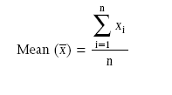
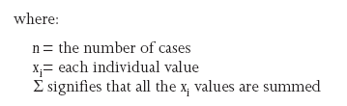
Understanding Data Via Descriptive Analysis
Measures of Central Tendency:
Mode: the value in a string of numbers that occurs most often
Median: the value whose occurrence lies in the middle of a set of ordered values
Mean: sometimes referred to as the “arithmetic mean”; the average value characterizing a set of numbers

Slide 128
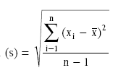
Understanding Data Via Descriptive Analysis
Measures of Variability:
Frequency distribution reveals the number (percent) of occurrences of each number or set of numbers
Range identifies the maximum and minimum values in a set of numbers
Standard deviation indicates the degree of variation in a way that can be translated into a bell-shaped curve distribution

Slide 129
Types of Variables
Types of variables indicate which estimates you can calculate and which statistical tests you should use
Continuous variables:
Always numeric
Generally calculate measures such as the mean, median and standard deviation
Categorical variables:
Information that can be sorted into categories
Field investigation – often interested in dichotomous or binary (2-level) categorical variables
Cannot calculate mean or median but can calculate risk
Notes:
Before starting any data analysis, it is important to know what types of variables you are working with. The types of variables tell you which estimates you can calculate, and later, which types of statistical tests you should use. Remember, continuous variables are numeric (such as age in years or weight) while categorical variables (whether yes or no, male or female, or something else entirely) are just what the name says—categories.
For continuous variables, we generally calculate measures such as the mean (average), median and standard deviation to describe what the variable looks like. We use means and medians in public health all the time; for example, we talk about the mean age of people infected with E. coli, or the median number of household contacts for case-patients with chicken pox.
In a field investigation, you are often interested in dichotomous or binary (2-level) categorical variables that represent an exposure (ate potato salad or did not eat potato salad) or an outcome (had Salmonella infection or did not have Salmonella infection). For categorical variables, we cannot calculate the mean or median, but we can calculate risk. Remember, risk is the number of people who develop a disease among all the people at risk of developing the disease during a given time period. For example, in a group of firefighters, we might talk about the risk of developing respiratory disease during the month following an episode of severe smoke inhalation.

Slide 130
Univariate Data Analysis
Univariate data analysis-explores each variable in a data set separately
Serves as a good method to check the quality of the data
Inconsistencies or unexpected results should be investigated using the original data as the reference point
Frequencies can tell you if many study participants share a characteristic of interest (age, gender, etc.)
Graphs and tables can be helpful
Notes:
Univariate Data Analysis
Univariate data analysis is important for many reasons. Looking at each variable alone, we learn a lot about the information collected. Also, univariate analysis is a good method of checking the quality of the data. Inconsistencies or unexpected results should always be investigated, using the original data as the reference point.
Simple frequencies can tell you whether most cases are young, or whether most cases are female, or whether many study participants share some other characteristic in which you are interested. First, examine the univariate (one variable) distribution. Graphs and tables can give you a good idea of what your variables look like, and can also help you find some of the data cleaning problems noted above.

Slide 131
Univariate Data Analysis
Examining continuous variables can give you important information:
Do all subjects have data, or are values missing?
Are most values clumped together, or is there a lot of variation?
Are there outliers?
Do the minimum and maximum values make sense, or could there be mistakes in the coding?
Notes:
Continuous Variables
An initial look at continuous variables can give you several important pieces of information:
Do all subjects have data, or are values missing?
Are most values clumped together, or is there a lot of variation? (Figures 1a and 1b)
Are there outliers?
Do the minimum and maximum values make sense, or could there be mistakes in the coding?

Slide 132
Univariate Data Analysis
Commonly used statistics with univariate analysis of continuous variables:
Mean – average of all values of this variable in the dataset
Median – the middle of the distribution, the number where half of the values are above and half are below
Mode – the value that occurs the most times
Range of values – from minimum value to maximum value
Notes:
We can also conduct a univariate analysis of continuous variables to gain valuable information. Commonly used statistics include these:
Mean – average of all values of this variable in the dataset.
Median – the middle of the distribution, the number where half of the values are above and half are below.
Mode – the value that occurs most.
Range of values – from minimum value to maximum value.

Slide 133
Standard Deviation
Figure left: narrowly distributed age values (SD = 7.6)
Figure right: widely distributed age values (SD = 20.4)
Notes:
Another statistic used is standard deviation
Standard deviation is a measure of how variable the data are. In the figure on the right, the standard deviation is 20.4; in the figure on the left, it is 7.6. A large standard deviation compared to the values of the variable indicates that the data are widely distributed. Standard deviations can be calculated most easily with a software program, although they can be calculated by hand.

Slide 134
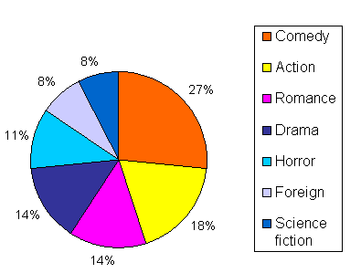
Pie Chart

Slide 135
Distribution and Percentiles
Distribution – whether most values occur low in the range, high in the range, or grouped in the middle
Percentiles – the percent of the distribution that is equal to or below a certain value
Distribution curves for variable AGE
25th Percentile
(4 years)
25th Percentile
(6 years)
Notes:
Additional statistics include:
Distribution – shows whether most values occur low in the range, high in the range, or grouped in the middle.
Percentiles – the percent of the distribution that is equal to or below a certain value. In the top figure the 25th percentile occurs at 4 years because 25% of the total number of respondents are 4 years or younger while in the bottom figure the 25th percentile occurs at 6 years. The top figure is a “bell-shaped” distribution while the bottom figure is a skewed distribution.

Slide 136
1-D (Univariate) Data
Representations
7
5
3
1
Tukey box plot
low
Middle 50%
high
Mean
0
20
Histogram

Slide 137
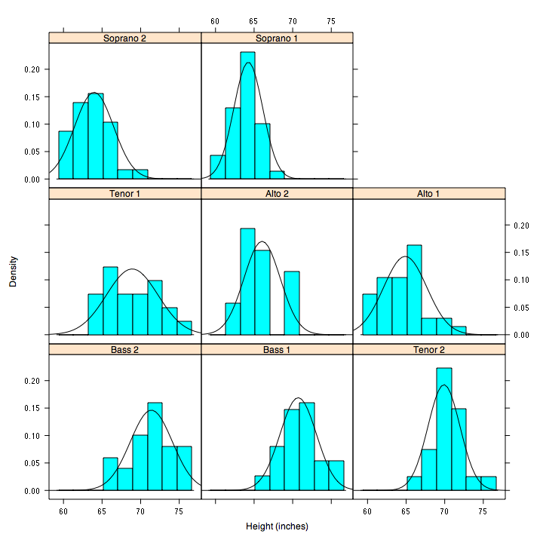
But be careful with axes and scales!

Slide 138
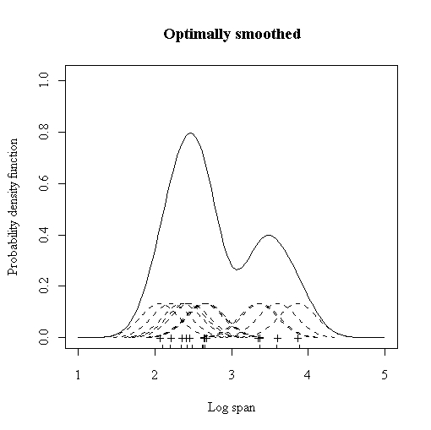
Smoothed Histograms - Density Estimates
Kernel estimates smooth out the contribution of each datapoint over a local neighborhood of that point.
h is the kernel width
Gaussian kernel is common:

Slide 139
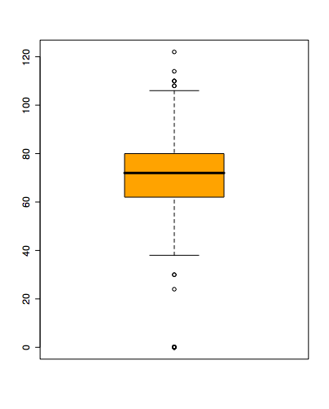
Boxplots
Shows a lot of information about a variable in one plot
Median
IQR
Outliers
Range
Skewness
Negatives
Overplotting
Hard to tell distributional shape
no standard implementation in software (many options for whiskers, outliers)

Slide 140
2D Analysis
- Scatter-Plot
- Linear Regression
- Correlation Coefficients
- Box-Plot

Slide 141
2-D (Bivariate) Data
Scatter plot, …
price
mileage

Slide 142
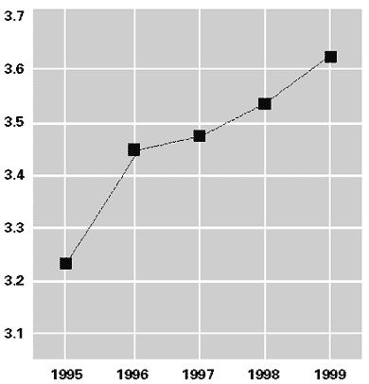
Line graphs

Slide 143
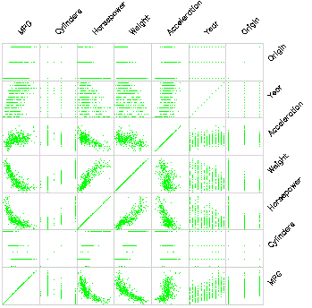
Scatterplot Matrix
Represent each possible
pair of variables in their
own 2-D scatterplot
(car data)
Q: Useful for what?
A: linear correlations
(e.g. horsepower & weight)
Q: Misses what?
A: multivariate effects

Slide 144
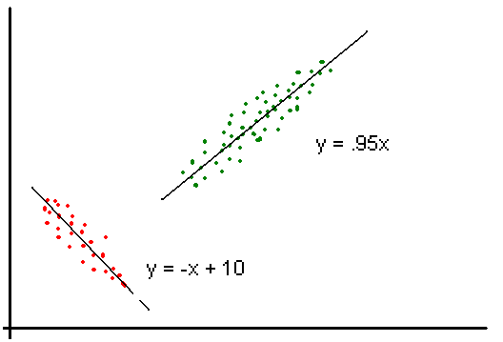
Scatter Plot with Regression Lines

Slide 145
Unsupervised Learning Linear Classifier
Given some set of features with corresponding labels, learn a function to predict the labels from the features
x
x
x
x
x
x
o
x
x
o
o
o
o
x2
x1

Slide 146
Classification: Linear Regression
Linear Regression
w₀ + w₁ x + w₂ y >= 0
Regression computes wi from data to minimize squared error to ‘fit’ the data
Not flexible enough

Slide 147
Multivariate Data
Multivariate Data

Slide 148
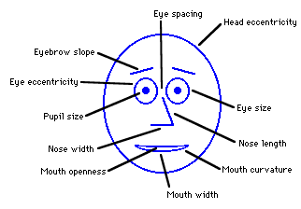
Chernoff Faces
Encode different variables’ values in characteristics
of human face
Cute applets:
http://www.cs.uchicago.edu/~wiseman/chernoff/
http://hesketh.com/schampeo/projects/Faces/chernoff.html

Slide 149
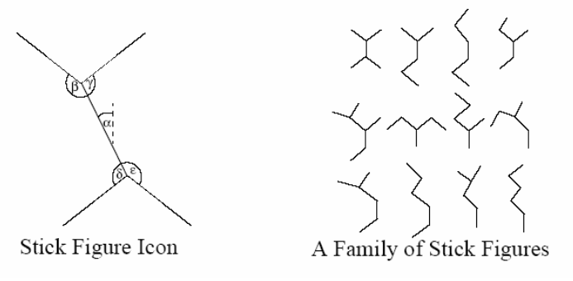
Stick Figures
Two variables are mapped to X, Y axes
Other variables are mapped to limb lengths and angles
Texture patterns can show data characteristics

Slide 150
Clustering
- Centroid-based clustering
- Hierarchical Clustering
-- Agglomerative Clustering
-- Divisive Clustering

Slide 151
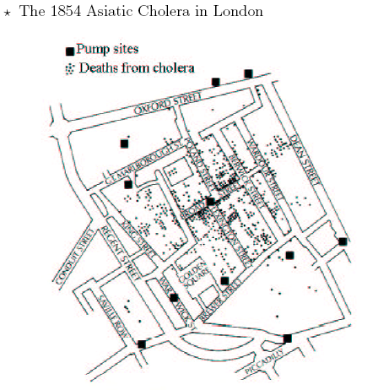
Spatial Cluster

Slide 152
Clustering
The goal of clustering is to
group data points that are close (or similar) to each other
identify such groupings (or clusters) in an unsupervised manner
Unsupervised: no information is provided to the algorithm on which data points belong to which clusters
Example
What should the clusters be for these data points?
x
x
x
x
x
x
x
x
x

Slide 153
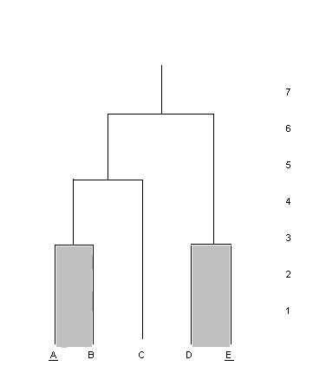
Dendrogram
Intuitive representation - hierarchical decomposition of data into sets of nested clusters.
From an agglomerative perspective:
Each leaf - a single data entity
Each internal node - the union of all data entities in its sub-tree
The root - the entire dataset
The height of any internal node - the similarity between its ‘children’.
Notes:
If the height is short, the children are very similar. If the height is tall, the children are not very similar.
This provides a very powerful 2 dimensional representation of the clustering as it not only presents which data clusters together, but also how ‘related’ the data is. The similarity between data is not so easily determined by some of the other clustering visualization techniques.

Slide 154
Dendrogram with Exemplars
The “most typical member of each cluster” [Wishart99]
Underlined labels of the leafs
Done in combination with shading to identify the clustering level
Notes:
that contains the exemplar. An example can be seen in Figure 14. Figure 14 shows that the two clusters being considered are {A, B} and {D, E}. Of the two clusters considered, it shows that A is the exemplar of {A, B} and E is the exemplar of {D, E}.

Slide 155
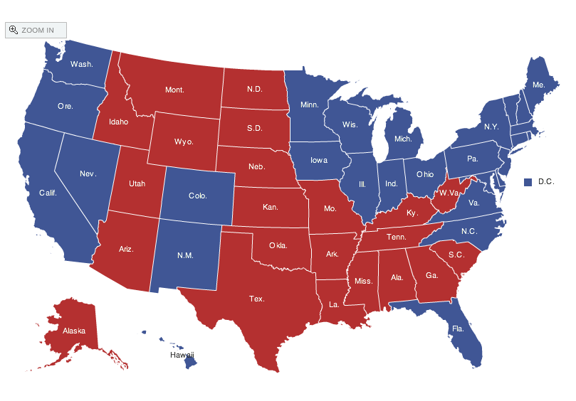
Spatial data: choropleth Maps
Maps using color shadings to represent numerical values are called chloropleth maps
http://elections.nytimes.com/2008/results/president/map.html

Slide 156
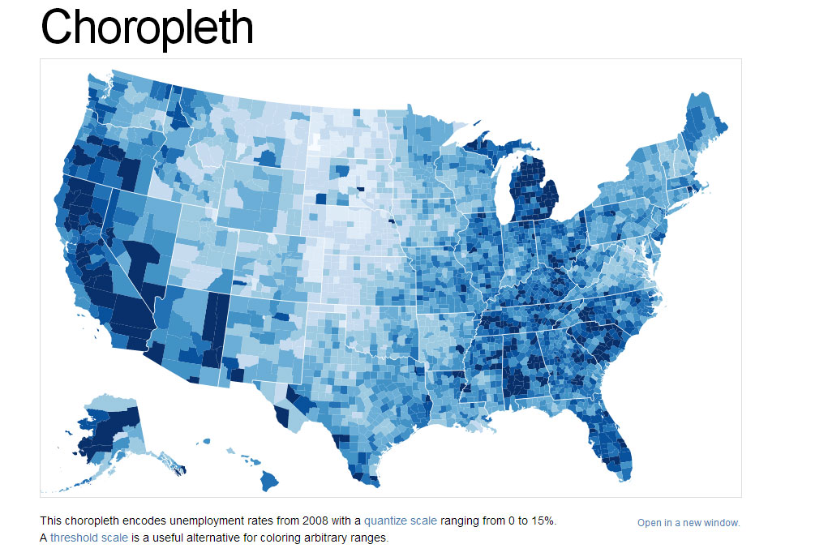

Slide 157
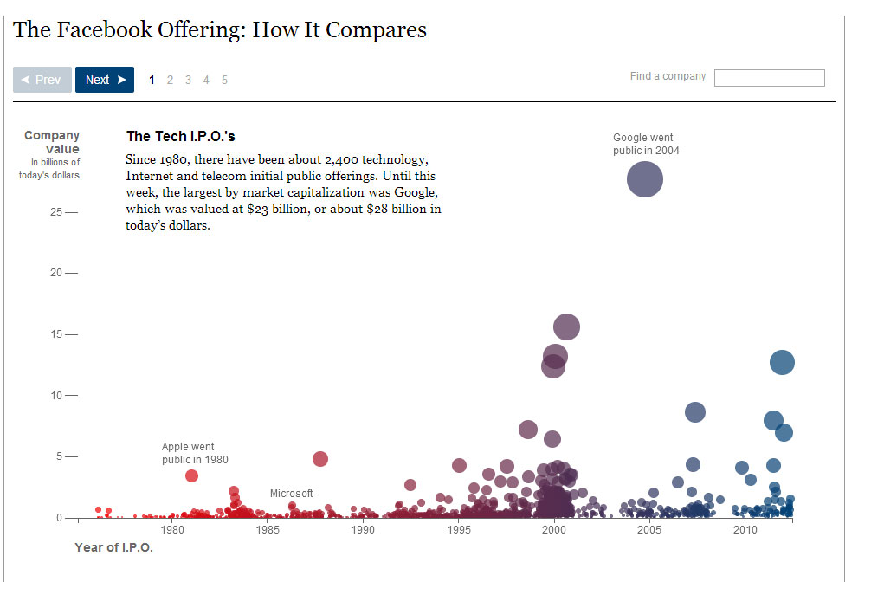

Slide 158
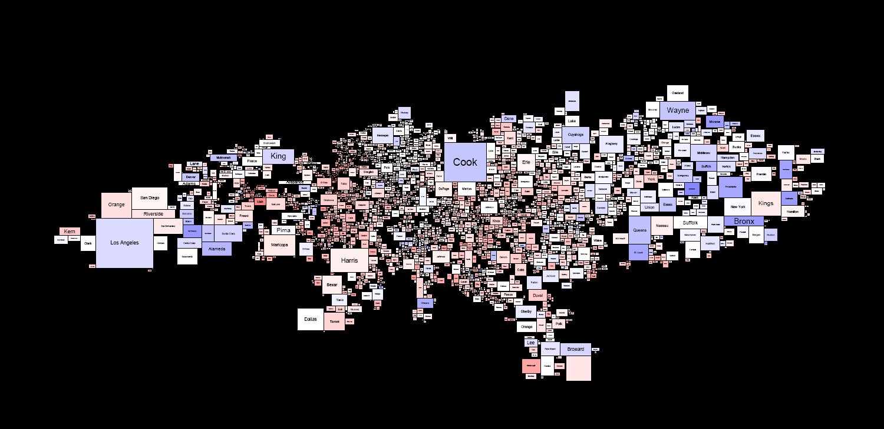
Rectangular Cartograms: 2004 Election Results

Slide 159
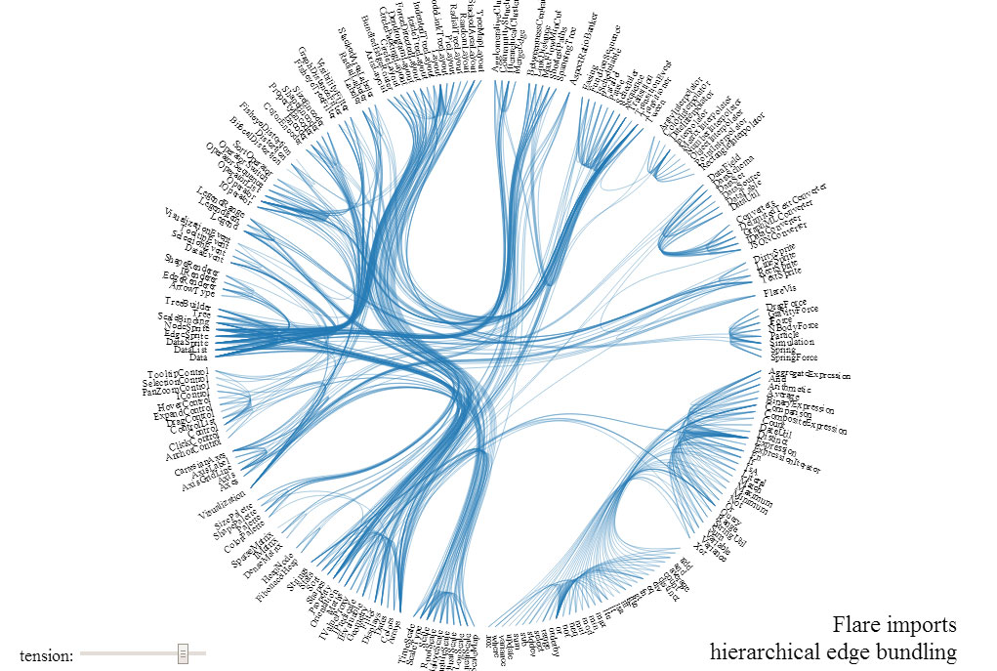

Slide 160
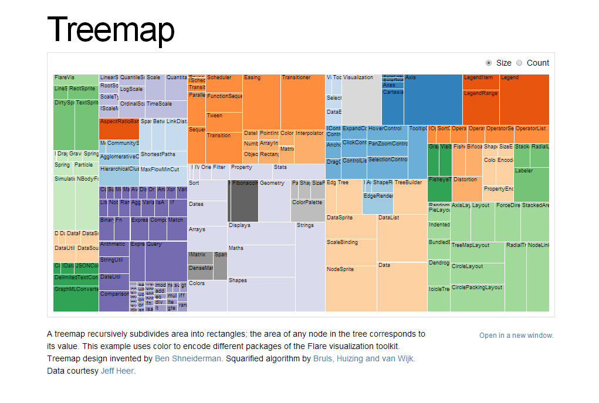

Slide 161
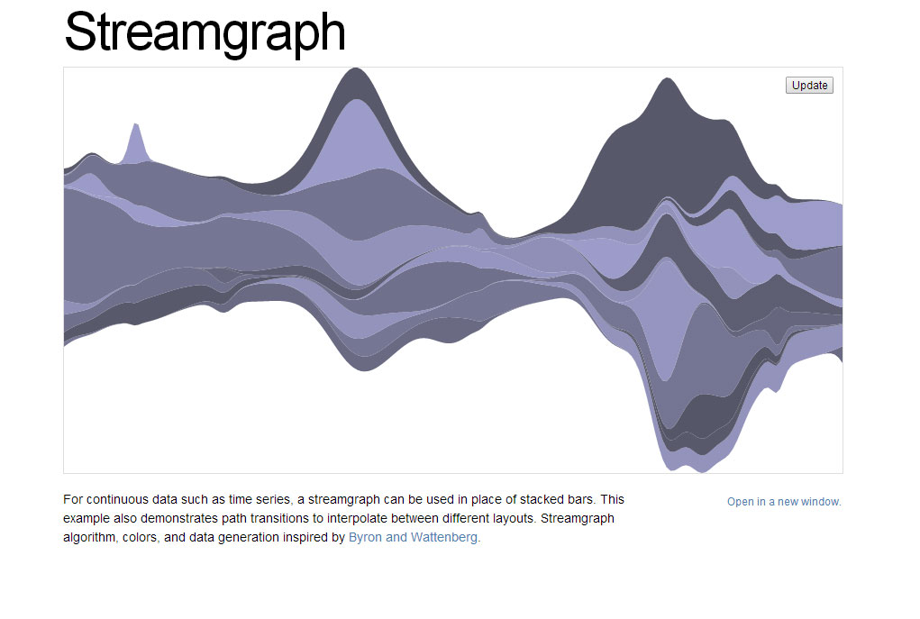

Slide 162
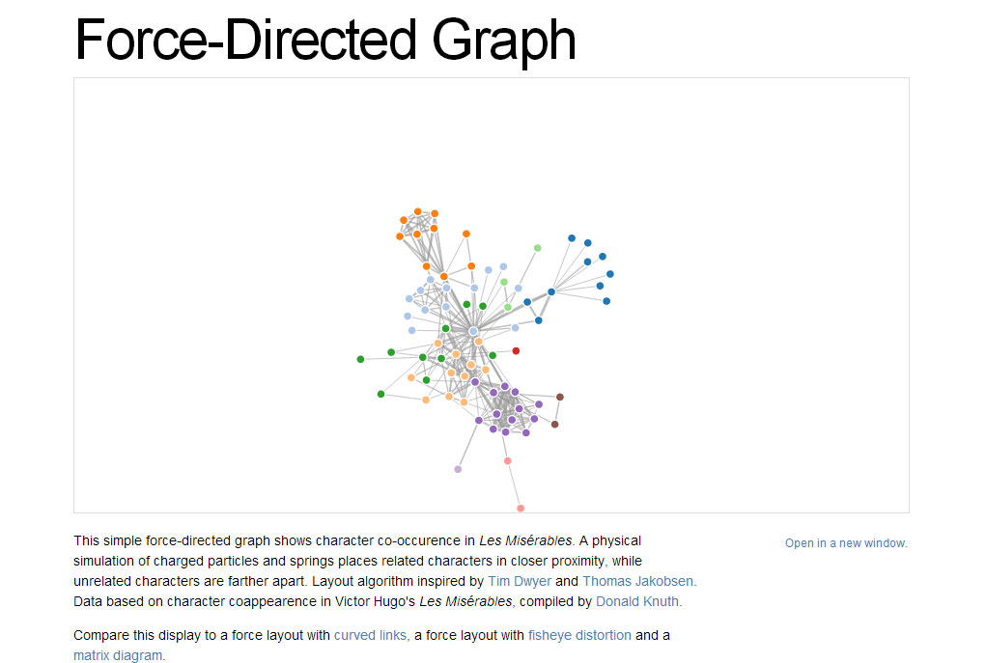

Slide 163
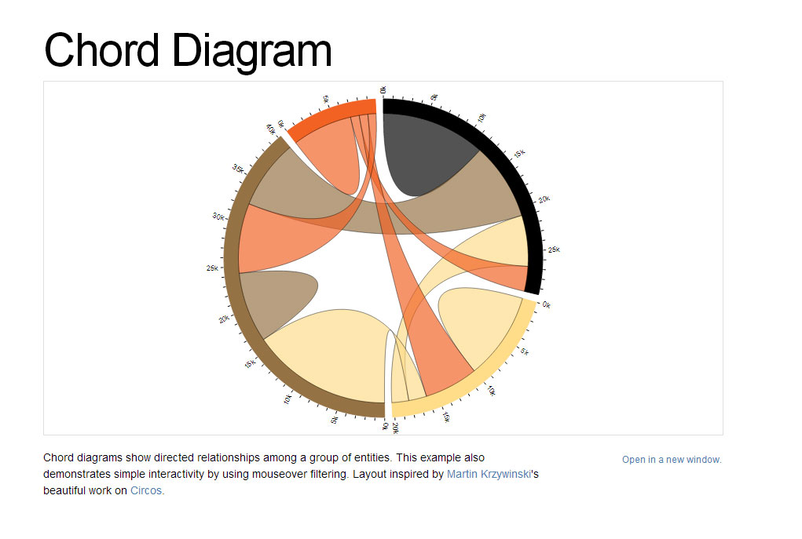

Slide 164
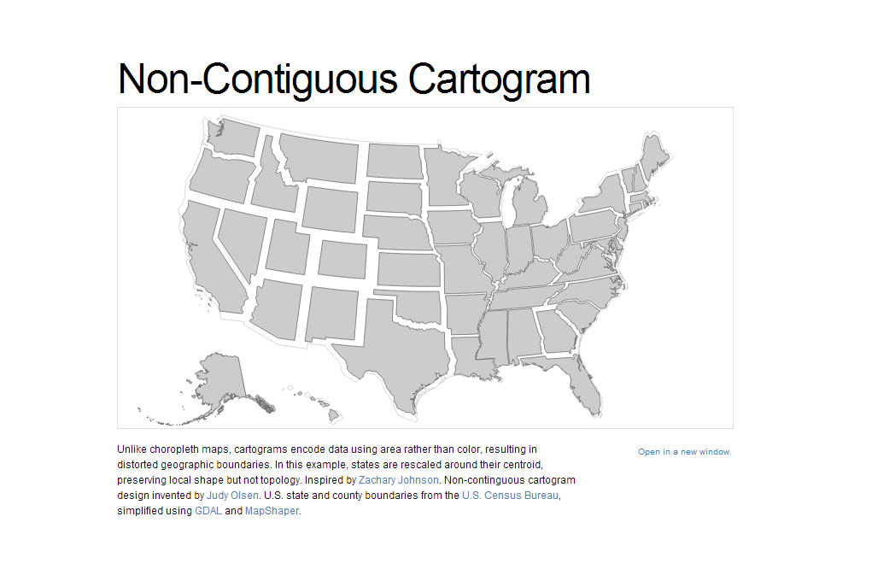

Slide 165
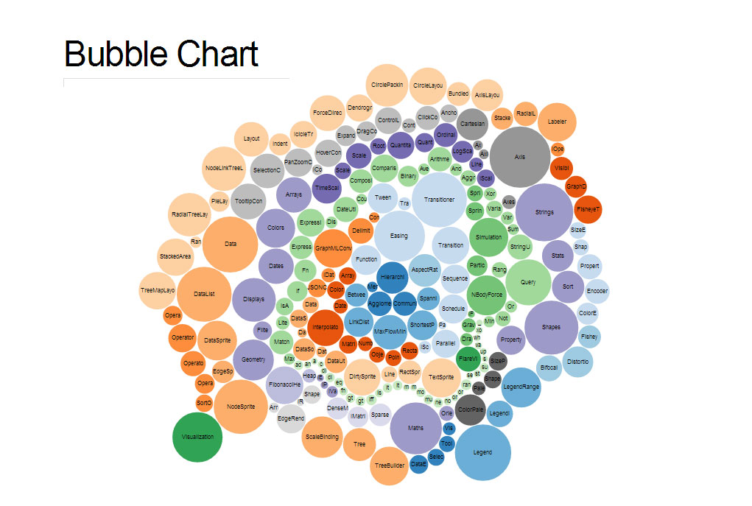

Slide 166


Slide 167
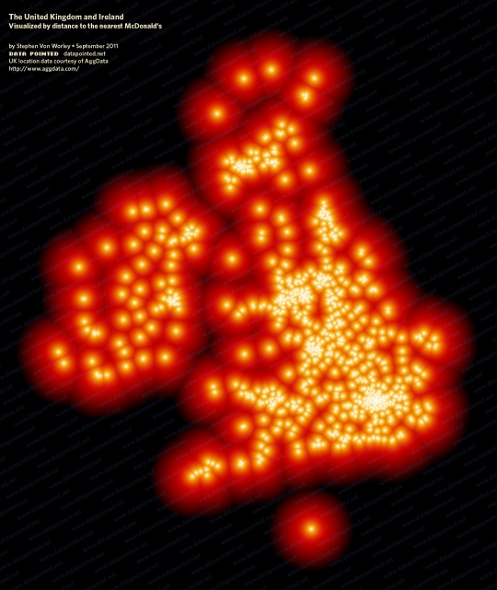

Slide 168

http://www.datapointed.net/2014/10/maps-of-street-grids-by-orientation/

Slide 169


http://www.datapointed.net/2014/10/maps-of-street-grids-by-orientation/

Slide 170
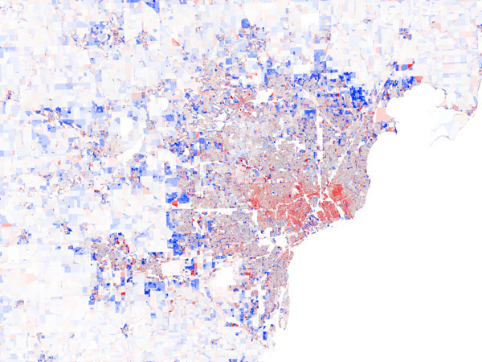

Slide 171


Slide 172
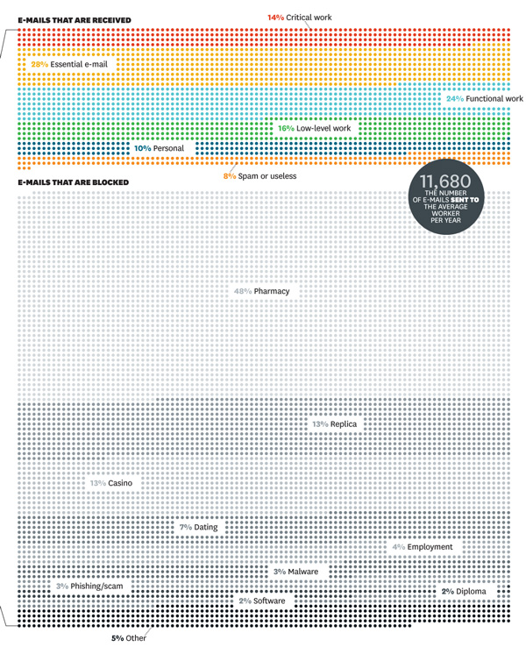

Slide 173
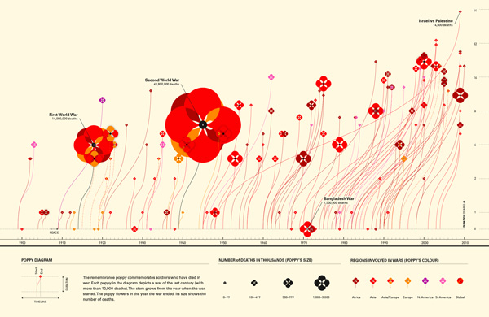

Slide 174
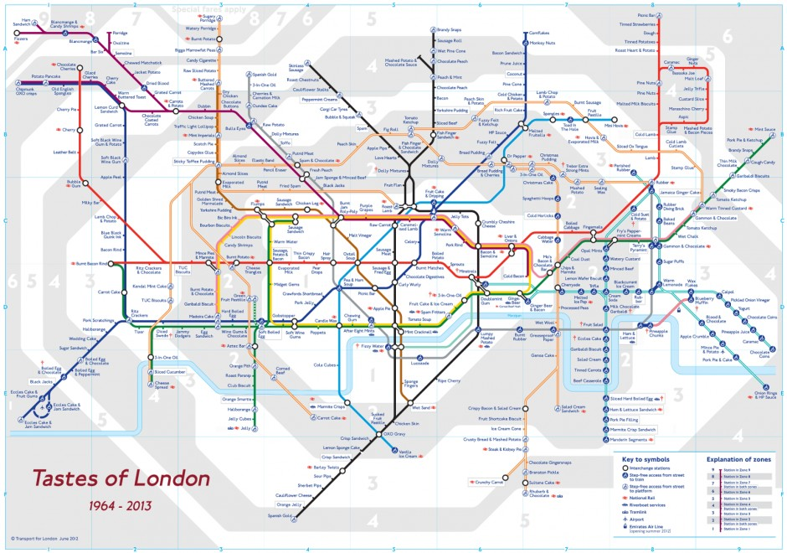

Slide 175


Slide 176
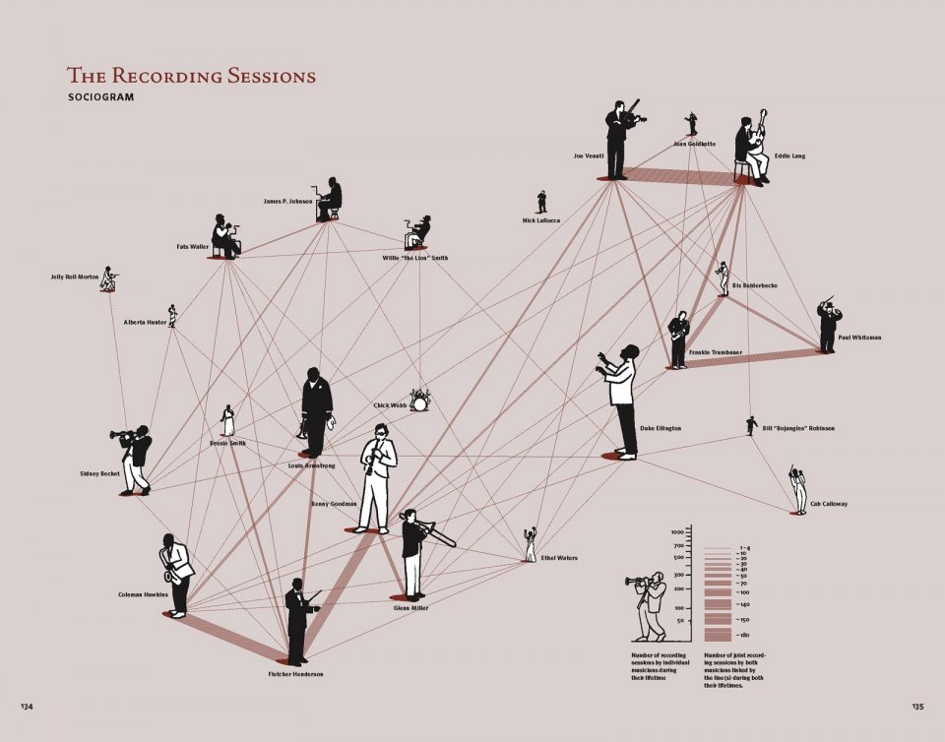

Slide 177
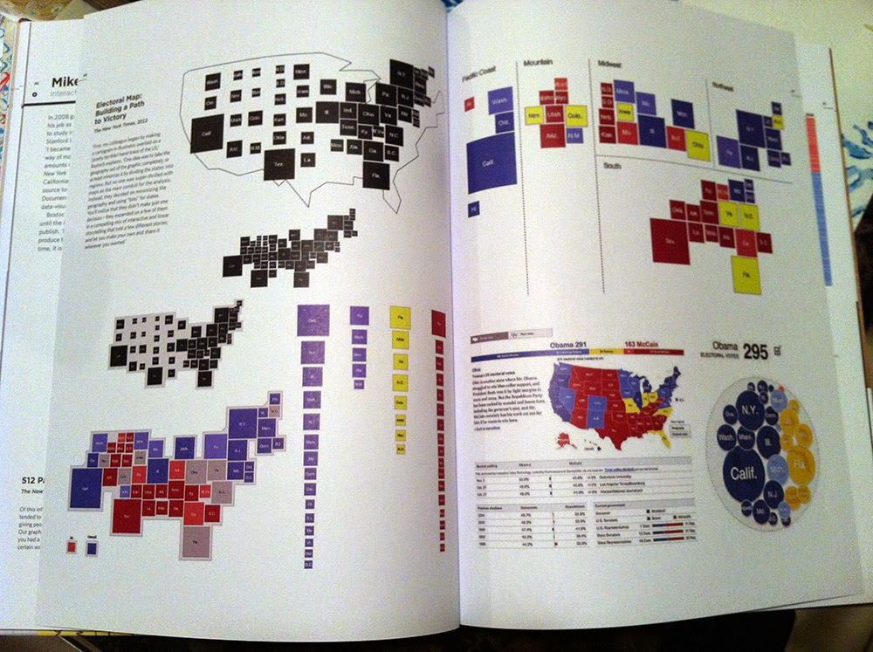

Slide 178
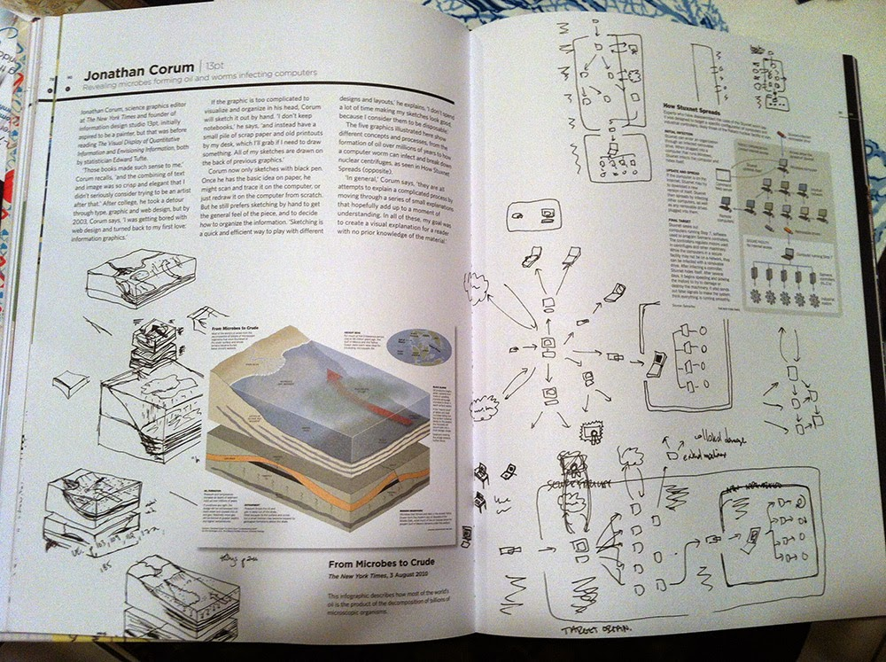

Slide 179
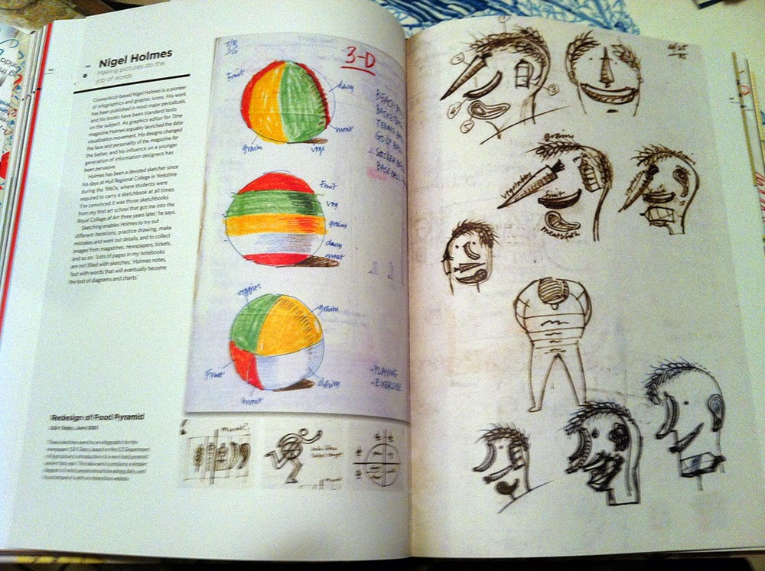

Slide 180
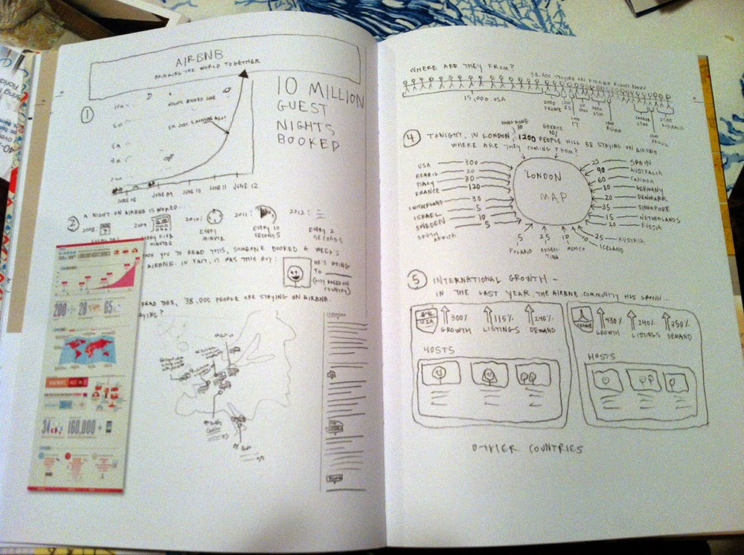

Slide 181



Slide 182
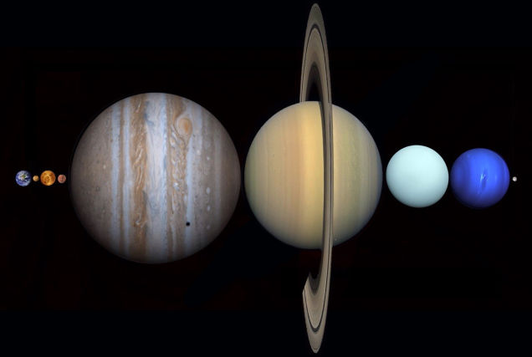

Slide 183

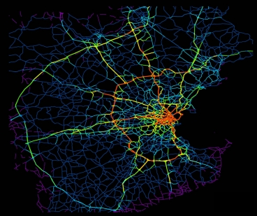

Slide 184
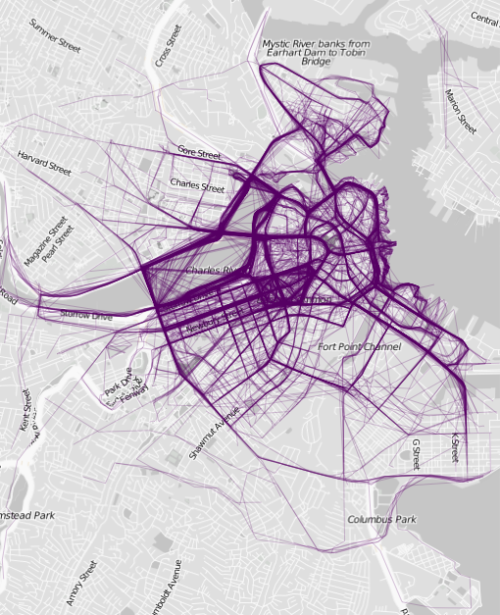

Slide 185
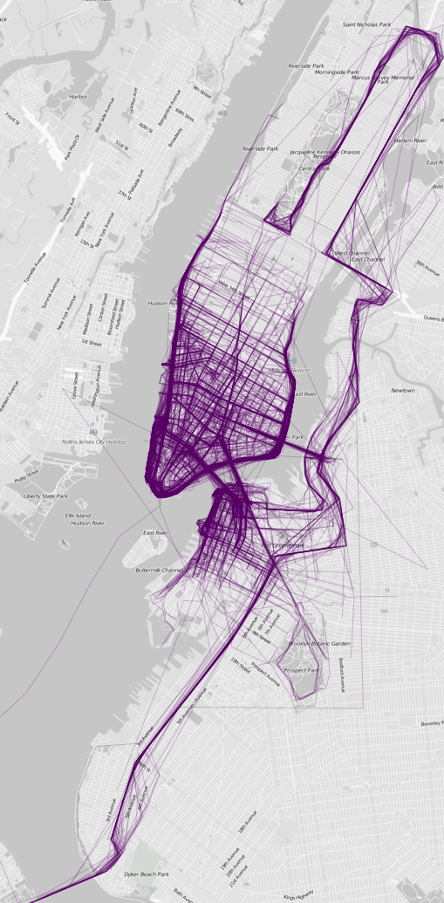

Slide 186
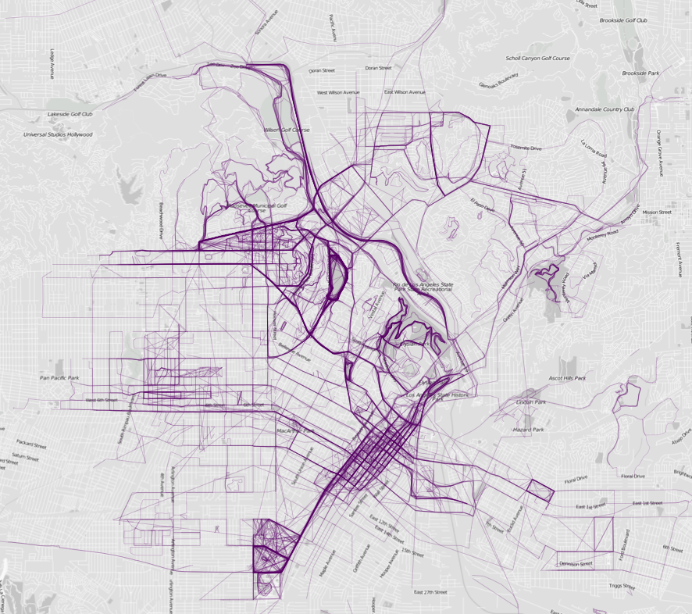

Slide 187


Slide 188


Slide 189

Selected maps from Atlas of the Habitual by Tim Clark, http://www.tlclark.com/atlasofthehabitual/

Slide 190

Location Data Is Being Used to Predict the Events You Will Want to Attend
http://www.technologyreview.com/view/526096/how-your-location-data-is-being-used-to-predict-the-events-you-will-want-to-attend/

Slide 191

Planes In The Air Right Now
http://www.buzzfeed.com/samir/this-map-of-planes-in-the-air-right-now-will-blow-your-mind

Slide 192

Algorithm Fixes Weather Radar Images Distorted by Wi-Fi
http://www.technologyreview.com/view/527231/algorithm-fixes-weather-radar-images-distorted-by-wi-fi/

Slide 193

Social Media Analysis Reveals The Complexities Of Syrian Conflict
http://www.technologyreview.com/view/524386/social-media-analysis-reveals-the-complexities-of-syrian-conflict/

Slide 194

Twitter Datastream Used to Predict Flu Outbreaks
http://www.technologyreview.com/view/520116/twitter-datastream-used-to-predict-flu-outbreaks/

Slide 195


Algorithmic Music
http://www.technologyreview.com/view/426309/the-emerging-art-of-algorithmic-music/
YouTube: https://www.youtube.com/watch?v=tCRPUv8V22o

Slide 196

Sharing Cascades on Facebook
http://www.technologyreview.com/view/525821/the-curious-nature-of-sharing-cascades-on-facebook/

Slide 197

Up Close on Baseball’s Borders
http://nyti.ms/1jlxOTf

Slide 198


From New York Times

Slide 199

http://grantland.com/the-triangle/true-value-breaking-down-kevin-durants-past-present-and-future/

Slide 200

http://www.hongkiat.com/blog/infographics-web-designers/

Slide 201

Information Art
from http://d3js.org/

Slide 202

Information Art
from http://d3js.org/

Slide 203






















































http://selection.datavisualization.ch/
from http://d3js.org/ && http://selection.datavisualization.ch/

Slide 204





d3js.org/
from http://d3js.org/
&& https://github.com/mbostock/d3/wiki/Gallery

Slide 205


flowingdata.com
From http://flowingdata.com/

Slide 206

Neurons sparkle as they send messages
Neurons sparkle as they send messages: http://youtu.be/N_ynH3BeKIo

Slide 207

Halloween costume rankings
http://flowingdata.com/2014/10/29/halloween-costume-rankings/

Slide 208

Basketball shots
http://flowingdata.com/2014/11/04/basketball-shot/

Slide 209


Slide 210


Slide 211


Slide 212


Slide 213


Slide 214


Slide 215


Slide 216
Measures of Association
Strength of the association between two variables, such as an exposure and a disease
Two measure of association used most often are the relative risk, or risk ratio (RR), and the odds ratio (OR)
The decision to calculate an RR or an OR depends on the study design
Interpretation of RR and OR:
RR or OR = 1: exposure has no association with disease
RR or OR > 1: exposure may be positively associated with disease
RR or OR < 1: exposure may be negatively associated with disease
Notes:
We usually collect information on exposure and disease because we want to compare two or more groups of people. To do this, we calculate measures of association. Measures of association tell us the strength of the association between two variables, such as an exposure and a disease. The two measures of association that we use most often are the relative risk, or risk ratio (RR), and the odds ratio (OR). The decision to calculate an RR or an OR depends on the study design. We interpret the RR and OR as follows:
RR or OR = 1: exposure has no association with disease
RR or OR > 1: exposure may be positively associated with disease
RR or OR < 1: exposure may be negatively associated with disease

Slide 217
Risk Ratio or Odds Ratio?
Risk ratio
Used when comparing outcomes of those who were exposed to something to those who were not exposed
Calculated in cohort studies
Cannot be calculated in case-control studies because the entire population at risk is not included in the study
Odds ratio
Used in case-control studies
Odds of exposure among cases divided by odds of exposure among controls
Provides a rough estimate of the risk ratio
Notes:
The risk ratio, or relative risk, is used when we look at a population and compare the outcomes of those who were exposed to something to the outcomes of those who were not exposed. When we conduct a cohort study, we can calculate risk ratios.
However, the case-control study design does not allow us to calculate risk ratios, because the entire population at risk is not included in the study. That’s why we use odds ratios for case-control studies. An odds ratio is the odds of exposure among cases divided by the odds of exposure among controls, and it provides a rough estimate of the risk ratio.
So remember, for a cohort study, calculate a risk ratio, and for a case-control study, calculate an odds ratio. For more information about calculating risk ratios and odds ratios, take a look at FOCUS Volume 3, Issues 1 and 2.

Slide 218
Calculating an Odds Ratio
Table 1. Sample 2x2 table for Pokemon eating salsa
 | Outcome
Exposure |  | Pokemon | No Pokemon | Total
 | Ate salsa | 218 | 45 | 263
 | Did not eat salsa | 21 | 85 | 106
 | Total | 239 | 130 | 369
Table displays data from a case control study
Can calculate the odds ratio:
*OR = ad = (218)(85) = 19.6
bc (45)(21)
Notes:
Table 1 displays data from a case-control study conducted in Pennsylvania in 2003. (2)
So what measure of association can we get from this 2x2 table? Since we do not know the total population at risk (everyone who ate salsa), we cannot determine the risk of illness among the exposed and unexposed groups. That means we should not use the risk ratio. Instead, we will calculate the odds ratio, which is exactly what the study authors did. They found an odds ratio of 19.6*, meaning that the odds of getting Hepatitis A among people who ate salsa were 19.6 times as high as among people who did not eat salsa.

Slide 219
Confidence Intervals
Point estimate – a calculated estimate (like risk or odds) or measure of association (risk ratio or odds ratio)
The confidence interval (CI) of a point estimate describes the precision of the estimate
The CI represents a range of values on either side of the estimate
The narrower the CI, the more precise the point estimate (3)
Notes:
How do we know whether an odds ratio of 19.6 as in the preceding example is meaningful in our investigation? We can start by calculating the confidence interval (CI) around the odds ratio. When we calculate an estimate (like risk or odds), or a measure of association (like a risk ratio or an odds ratio), that number (in this case 19.6) is called a point estimate. The confidence interval of a point estimate describes the precision of the estimate. It represents a range of values on either side of the estimate. The narrower the confidence interval, the more precise the point estimate. (3) Your point estimate will usually be the middle value of your confidence interval.

Slide 220
Confidence Intervals - Example
Example—large bag of 500 red, green and blue marbles:
You want to know the percentage of green marbles but don’t want to count every marble
Shake up the bag and select 50 marbles to give an estimate of the percentage of green marbles
Sample of 50 marbles:
15 green marbles, 10 red marbles, 25 blue marbles
Notes:
An analogy can help explain the confidence interval. Say we have a large bag of 500 red, green, and blue marbles. We are interested in knowing the percentage of green marbles, but we do not have the time to count every marble. So we shake up the bag and select 50 marbles to give us an idea, or an estimate, of the percentage of green marbles in the bag. In our sample of 50 marbles, we find 15 green marbles, 10 red marbles, and 25 blue marbles.

Slide 221
Confidence Intervals
Marble example continued:
Based on sample we conclude 30% (15 out of 50) marbles are green
30% = point estimate
How confident are we in this estimate?
Actual percentage of green marbles could be higher or lower, ie. sample of 50 may not reflect distribution in entire bag of marbles
Can calculate a confidence interval to determine the degree of uncertainty
Notes:
Based on this sample, we can conclude that 30% (15 out of 50) of the marbles in the bag are green. In this example, 30% is the point estimate. Do we feel confident in stating that 30% of the marbles are green? We might have some uncertainty about this statement, since there is a chance that the actual percent of green marbles in the entire bag is higher or lower than 30%. In other words, our sample of 50 marbles may not accurately reflect the actual distribution of marbles in the whole bag of 500 marbles. One way to determine the degree of our uncertainty is to calculate a confidence interval.

Slide 222
Confidence Intervals
Very narrow confidence intervals indicate a very precise estimate
Can get a more precise estimate by taking a larger sample
100 marble sample with 30 green marbles
Point estimate stays the same (30%)
95% confidence interval is 21-39% (rather than 17-43% for original sample)
200 marble sample with 60 green marbles
Point estimate is 30%
95% confidence interval is 24-36%
CI becomes narrower as the sample size increases
Notes:
Ideally, we would like a very narrow confidence interval, which would indicate that our estimate is very precise. One way to get a more precise estimate is to take a larger sample. If we had taken 100 marbles (instead of 50) from our bag and found 30 green marbles, the point estimate would still be 30%, but the 95% confidence interval would be a range of 21-39% (instead of our original range of 17-43%). If we had sampled 200 marbles and found 60 green marbles, the point estimate would be 30%, and with a 95% confidence interval the range would be 24-36%. You can see that the confidence interval becomes narrower as the sample size increases.

Slide 223
Analysis of Categorical Data
Measure of association (risk ratio or odds ratio)
Confidence interval
Chi-square test
A formal statistical test to determine whether results are statistically significant
Notes:
Analysis of Categorical Data
You have calculated a measure of association (a risk ratio or odds ratio), and a confidence interval for a range of values around the point estimate. Now you want to use a formal statistical test to determine whether the results are statistically significant. Here, we will focus on the statistical tests that are used most often in field epidemiology. The first is the chi-square test.

Slide 224
Chi-Square Statistics
A common analysis is whether Pokemon X occurs as much among people in Group A as it does among people in Group B
People are often sorted into groups based on their Pokemon preference
We then perform a test of the association between preference and Pokemon in the two groups
Notes:
Chi-Square Statistics
As noted earlier, a common analysis in epidemiology involves dichotomous variables, and uses a 2x2 table. We want to know if Disease X occurs as much among people belonging to Group A as it does among people belonging to Group B. In epidemiology, we often put people into groups based on their exposure to some disease risk factor.
To determine whether those persons who were exposed have more illness than those not exposed, we perform a test of the association between exposure and disease in the two groups. Let’s use a hypothetical example to illustrate this.

Slide 225
Chi-Square Test: XBox and Pikachu
Cohort study: XBox and Pikachu
 | Like Pikachu?
 | Yes | No | Total
XBox | 41 | 89 | 130
No XBox | 19 | 151 | 170
Total | 60 | 240 | 300
To see if there is a statistical difference those who like Pikachu and those who own an Xbox we could conduct a chi-square test
Notes:
Table 2a shows the number of people who did and did not eat tomatoes from the salad bar.
To see if there is a significant difference in the amount of illness between those who ate tomatoes (41/130 or 32%) and those who did not (19/170 or 11%), one test we could conduct is a handy little statistic called χ2 (or chi-square).

Slide 226
Chi-Square Test: XBox and Pikachu
To conduct a chi-square the following conditions must be met:
There must be at least a total of 30 observations (people) in the table
Each cell must contain a count of 5 or more
To conduct a chi-square test we compare the observed data (from study results) with the data we would expect to see
Notes:
In order to calculate a run-of-the mill chi-square, the following conditions must be met:
There must be at least a total of 30 observations (people) in the table.
Each cell must contain a count of 5 or more.
To conduct a chi-square test, we compare the observed data (from our study results) to the data we would expect to see.

Slide 227
Chi-Square Test: XBox and Pikachu
Expected Value = Row Total x Column Total
Grand Total
For the first cell, people who own XBox and like Pikachu:
Expected value = 130 x 60 = 26
300
Same formula can be used to calculate the expected values for each of the cells
Notes:
Expected Value = Row Total x Column Total
Grand Total
For the first cell, people who ate tomatoes and became ill:
Expected Value = 130 x 60 = 26
300
We can use this formula to calculate the expected values for each of the cells, as shown in Table 2c.

Slide 228
Chi-Square Test: XBox and Pikachu
Expected values for XBox and Pikachu
 | Like Pikachu?
 | Yes | No | Total
XBox | 130 x 60 = 26 300 | 130 x 240 = 104 300 | 130
No XBox | 170 x 60 = 34 300 | 170 x 240 = 136 300 | 170
Total | 60 | 240 | 300
To calculate the chi-square statistic you use the observed values from the table.
Formula is [(Observed – Expected)²/Expected] for each cell of the table
Notes:
To calculate the chi-square statistic, you use the observed values from Table 2a and the expected values that we calculated in Table 2c. You use this formula: [(Observed – Expected)2/ Expected] for each cell in the table. Then you add these numbers together to find the chi-square statistic.

Slide 229
Chi-Square Test: XBox and Pikachu
Expected values for XBox and Pikachu
 | Like Pikachu?
 | Yes | No | Total
XBox | (41-26)² = 8.7 26 | (89-104)² = 2.2 104 | 130
No XBox | (19-34)² = 6.6 34 | (151-136)² = 1.7 136 | 170
Total | 60 | 240 | 300
The chi-square (χ2) for this example is 19.2
8.7 + 2.2 + 6.6 + 1.7 = 19.2
Notes:
The chi-square (χ2) for this example is 19.2 ( 8.7 + 2.2 + 6.6 + 1.7 = 19.2).

Slide 230
Chi-Square Test
What does the chi-square tell you?
In general, the higher the chi-square value, the greater the likelihood there is a statistically significant difference between the two groups you are comparing
To know for sure, you need to look up the p-value in a chi-square table
We will discuss p-values after a discussion of different types of chi-square tests
Notes:
What exactly does this number tell you? In general, the higher the chi-square value, the greater the likelihood that there is a statistically significant difference between the two groups you are comparing. To know for sure, though, you need to look up the p-value in a chi-square table. We will talk about the p-value and how the p-value is related to the chi-square test in the section below. First, though, let’s talk about different types of chi-square tests.

Slide 231
Types of Statistical Tests
Parade of Statistics Guys
The right test... | To use when….
Pearson chi-square (uncorrected) | Sample size >100 Expected cell counts > 10
Yates chi-square (corrected) | Sample size >30 Expected cell counts ≥ 5
Mantel-Haenszel chi-square | Sample size > 30 Variables are ordinal
Fisher’s exact test | Sample size < 30 and/or Expected cell counts < 5
Notes:
The figure identifies the types of tests to use in different situations. If you have a sample with less than 30 people or if one of the cells in your 2x2 tables is less than 5, you will need to use Fisher’s exact test. If you have matched or paired data, you should use McNemar’s Test instead of a standard chi-square test (we’ll talk more about McNemar’s Test in the next issue of FOCUS).

Slide 232
P-Values
Many statistical tests give both a numeric result (e.g. a chi-square value) and a p-value
The p-value ranges between 0 and 1
What does the p-value tell you?
The p-value is the probability of getting the result you got, assuming that the two groups you are comparing are actually the same
Notes:
Many statistical tests give both a numeric result (e.g., our chi-square value of 19.2) and a p-value. The p-value is a number that ranges between 0 and 1. So what does the p-value tell you? The p-value is the probability of getting the result you got, assuming that the two groups you are comparing are actually the same.

Slide 233
P-Values
Start by assuming there is no difference in outcomes between the groups
Look at the test statistic and p-value to see if they indicate otherwise
A low p-value means that (assuming the groups are the same) the probability of observing these results by chance is very small
Difference between the two groups is statistically significant
A high p-value means that the two groups were not that different
A p-value of 1 means that there was no difference between the two groups
Notes:
In other words, we start by assuming that there is no difference in outcomes between the groups (e.g., the people who ate tomatoes and those who did not). Then we look at the test statistic and p-value to see if they indicate otherwise. A low p-value means that, assuming the groups are actually the same, the probability of observing these results just by chance is very small. Therefore, you can call the difference between two groups statistically significant. A high p-value means that the two groups were not that different. A p-value of 1 means that there was no difference at all between the two groups.

Slide 234
P-Values
Generally, if the p-value is less than 0.05, the difference observed is considered statistically significant, ie. the difference did not happen by chance
You may use a number of statistical tests to obtain the p-value
Test used depends on type of data you have
Notes:
Generally, if the p-value is less than 0.05, the difference observed is considered statistically significant. Although this is somewhat arbitrary, we often consider statistically significant differences to be real. If the p-value is below 0.05, we conclude that the difference observed is a true difference and did not happen by chance.
A number of statistical tests can be employed to obtain the p-value. The test you use depends on the type of data you have.

Slide 235
Note: Assumptions
Statistical tests such as the chi-square assume that the observations are independent
Independence: value of one observation does not influence value of another
If this assumption is not true, you may not use the chi-square test
Do not use chi-square tests with:
Repeat observations of the same group of people (e.g. pre- and post-tests)
Matched pair designs in which cases and controls are matched on variables such as sex and age
Notes:
A cautionary note…
Statistical tests such as the chi-square are based on several assumptions about the data, including independence of observations. The assumption of independence means that the value of one observation does not influence the value of another observation.
If this assumption is not actually true in your study, then it is incorrect to use the test. Situations in which the chi-square test should not be used include: repeat observations of the same group of people (e.g., pre- and post-tests) and matched pair designs in which cases and controls are matched on variables such as age and sex. These situations require special data analysis methods.
Luckily for us, in most of the situations we face in field epidemiology, the assumptions of the chi-square test are met. For example, the people who ate the potato salad were not the same people as those who did not eat the potato salad.

Slide 236
Analysis of Continuous Data
Data do not always fit into discrete categories
Continuous numeric data may be of interest in a field investigation such as:
Clinical symptoms between groups of patients
Average age of patients compared to average age of non-patients
Respiratory rate of those exposed to a chemical vs. respiratory rate of those who were not exposed
Notes:
Analysis of Continuous Data
Data do not always fit into discrete categories but continuous numeric data can also be of interest in a field investigation. You might want to compare clinical symptoms between groups of patients. For example, you might want to compare the temperature (fever) of adult patients with that of children. You could compare the average age of patients to the average age of non-patients, or the respiratory rate of those who were directly exposed to a chemical plume to the rate of those who were not exposed.

Slide 237
ANOVA
May compare continuous data through the Analysis Of Variance (ANOVA) test
When comparing continuous variables between groups of study subjects:
Use a t-test for comparing 2 groups
Use an f-test for comparing 3 or more groups
Both tests result in a p-value
ANOVA uses either the t-test or the f-test
Example: testing age differences between 2 groups
If groups have similar average ages and a similar distribution of age values, t-statistic will be small and the p-value will not be significant
If average ages of 2 groups are different, t-statistic will be larger and p-value will be smaller (p-value <0.05 indicates two groups have significantly different ages)
Notes:
ANOVA
When comparing continuous variables between groups of study subjects, a test that results in a p-value is used. However, instead of using chi-square tests as we did for categorical data, we use a t-test (for comparing 2 groups) or an f-test (for comparing 3 or more groups). The ANOVA procedure uses either the t-test or the f-test, depending on the number of groups being compared. A t-test compares averages between two groups, takes into account the variability in each group, and results in a statistic (t) that has a p-value.
For example, let’s say that we are testing age differences between 2 groups. If the groups have very similar average ages and a similar “spread” or distribution of age values, the t-statistic will be relatively small and the p-value will not be significant (i.e., it will be >0.05). If the average ages of the 2 groups are quite different, the t-statistic will be larger, and the p-value will be smaller. If the p-value is less than 0.05, the groups have significantly different ages.

Slide 238
ANOVA and Bartlett’s Test
Critical assumption with t-tests and f-tests: groups have similar variances (e.g., “spread” of age values)
As part of the ANOVA analysis, software conducts a separate test to compare variances: Bartlett’s test for equality of variance
Bartlett’s test:
Produces a p-value
If Bartlett’s p-value >0.05, (not significant) OK to use ANOVA results
Bartlett’s p-value <0.05, variances in the groups are NOT the same and you cannot use the ANOVA results
Notes:
Bartlett’s Test
In t-tests and f-tests, there is one critical assumption that you should know about. ANOVA assumes that the two groups have similar variances. In other words, the two groups have a similar “spread” of age values. Think of it as comparing apples to apples. As part of the ANOVA analysis, the software program conducts a separate test just to see if the variances of the two groups are comparable. This test is called Bartlett’s test for equality of variance. The basic assumption for this test is that the variances are comparable.
If you see a p-value for the test that is larger than 0.05, which is not significant, everything is fine. You can use the results of your ANOVA. However, if Bartlett’s p-value is less than 0.05, the variances in the groups are not the same and you cannot use the results of the ANOVA. In this situation there is another test that you can use in place of ANOVA: the Kruskal-Wallis test.

Slide 239
Kruskal-Wallis Test
Kruskal-Wallis test: generated by Epi Info software
Used only if Bartlett’s test reveals variances dissimilar enough so that you can’t use ANOVA
Does not make assumptions about variance, examines the distribution of values within each group
Generates a p-value
If p-value >0.05 there is not a significant difference between groups
If p-value < 0.05 there is a significant difference between groups
Notes:
Kruskal-Wallis Test
In Epi Info, a third test result is given that you will only need if Bartlett’s test told you that the variances were not similar enough to use ANOVA (i.e., the p-value of Bartlett’s test was less than 0.05). The Kruskal-Wallis test does not make assumptions about the variance in the data. The Kruskal-Wallis test does not test averages but examines the distribution of the values within each of the groups. The test will result in a p-value. If the p-value is larger than 0.05, then you can conclude that there is not a significant difference between the groups. If the p-value is less than 0.05, there is a significant difference between the groups.

Slide 240


Uniform Distribution
Consider the uniform probability distribution (sometimes called the rectangular probability distribution).
It is described by the function:
f(x)
a
b
x
area = width x height = (b – a) x = 1

Slide 241



The Normal Distribution
The normal distribution is the most important of all probability distributions. The probability density function of a normal random variable is given by:
It looks like this:
Bell shaped,
Symmetrical around the mean …

Slide 242



Exponential Distribution
Another important continuous distribution is the exponential distribution which has this probability density function:
Note that x ≥ 0. Time (for example) is a non-negative quantity; the exponential distribution is often used for time related phenomena such as the length of time between phone calls or between parts arriving at an assembly station. Note also that the mean and standard deviation are equal to each other and to the inverse of the parameter of the distribution (lambda )

Slide 243
Poisson Distribution
Distribution often used to model the number of incidences of some characteristic in time or space:
Arrivals of customers in a queue
Numbers of flaws in a roll of fabric
Number of typos per page of text.
Distribution obtained as follows:
Break down the “area” into many small “pieces” (n pieces)
Each “piece” can have only 0 or 1 occurrences (p=P(1))
Let λ=np ≡ Average number of occurrences over “area”
Y ≡ # occurrences in “area” is sum of 0^{s} & 1^{s} over “pieces”
Y ~ Bin(n,p) with p = λ/n
Take limit of Binomial Distribution as n →∞ with p = λ/n

Slide 244
Negative Binomial Distribution
Used to model the number of trials needed until the r^{th} Success (extension of Geometric distribution)
Based on there being r-1 Successes in first y-1 trials, followed by a Success

Slide 245

Lognormal Distribution

